Slide 1
World in Transition: The Expansion of Civilization

Slide 2
Essential Understanding
How did the development of religious traditions provide a bond among the people and an ethical code to live by?
How and why did belief systems and cultural traditions spread to new areas?
How did the development of religious traditions affect social classes, gender roles, and artistic expression?

Slide 3
What is the purpose of religion? Consider spiritual and practical purposes.

Slide 4
Confucianism
Started by Confucius (551-479 BCE) during the Warring States Period in China
Offers solutions to the problems plaguing China
Focus on life rather than the afterlife
Does not advocate a specific deity
Emphasizes worship of ancestors
Drawing of Confucius

Slide 5
Basic Beliefs of Confucianism
Emphasizes li
the “rituals” of everyday life
Goal is to promote harmony on Earth through relationships
Five Relationships
Filial Piety
Education
Dacheng Temple in Confucius’ hometown of Qufu in China.

Slide 6
Social Impact of Confucianism
Becomes foundation of Chinese government
Reinforced importance of patriarchal relationships
Reinforced family as the center of Chinese society
Japan, Korea, Taiwan, Singapore are influenced by Confucian ethic
Family altar in Malaysian Chinese home. Family is inviting ancestors to partake in the Hungary Ghost festival

Slide 7
Daoism (Taoism)
Founded by Laozi (6th cent. BCE?) during the Warring States Period
Everything revolves around the Dao
Goal: Create societal harmony by living according to the natural laws of the universe
Wu Wei “without action”

Slide 8
Impact of Daoism
Encourages respect for nature
Heavily influenced Chinese art and literature
Landscape paintings
Yoga and meditation
Hygiene and cleanliness
Medicine
Balance between Yin (feminine, dark) and Yang (masculine, light)

Slide 9
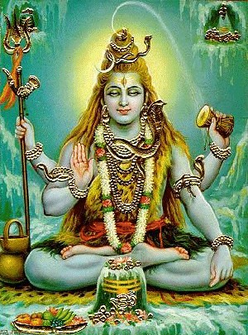
Hinduism
Began in India c.1500 BCE
One god in many different forms
Brahma, Vishnu, Shiva
Krishna
Sacred Texts
Vedas, Bhagavad Gita, Upanishads
Shiva, the Destroyer

Slide 10
Basic Beliefs of Hinduism
Atman
Major Ideas
Dharma (duty)
Karma (action)
Samsara (cycle of life)
Moksha (liberation)
Yogas
Paths or practices
Several different types
Kali, goddess of death and destruction

Slide 11
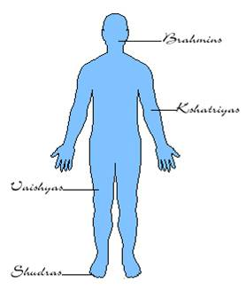
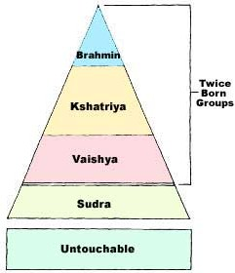
Social Impact of Hinduism

Slide 12
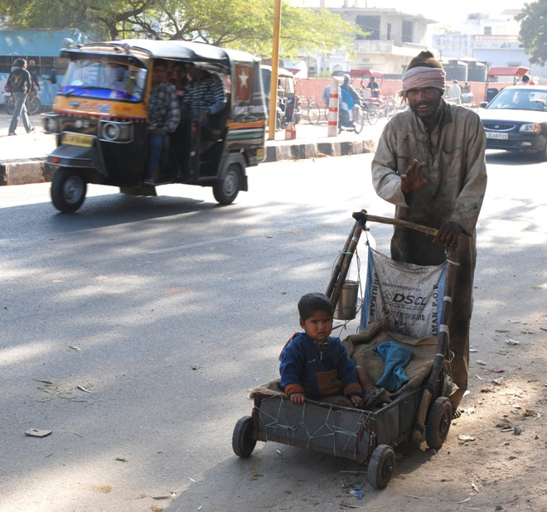
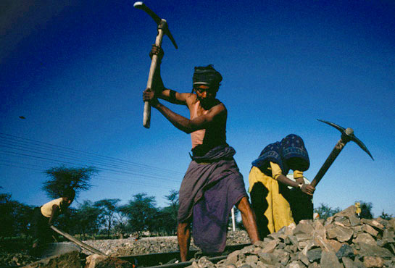
Modern Untouchables
Modern India has 160 million untouchables or approximately 15% of India’s population.

Slide 13
Buddhism
Founded by Siddhartha Gautama (563-483 BCE)
Born into kshatriya caste
Reform movement of Hinduism
No specific deity?
Rejects the atman
Believes in spiritual equality
No caste system

Slide 14
Basic Beliefs of Buddhism
Four Noble Truths
Life is suffering
Desire causes suffering
End suffering by ending desire
To end desire follow the Eightfold Path
Right view, right intention, right speech, right action, right livelihood, right effort, right mindfulness, right concentration
Buddhist Wheel of Life; the eight spokes represent the Eightfold Path

Slide 15
Spread of Buddhism

Slide 16
Social Impact of Buddhism
Spread to Central Asia, East Asia, & SE Asia
Often blends with existing beliefs
Built monasteries for men and women
Provides elite women an alternative to traditional living

Slide 17
Zoroastrianism
Founded by Zarathushtra (Zoroaster) c. 600 BCE
God Ahura Mazda which produces only good
Evil is always trying to destroy the work of Ahura Mazda
Became the state religion of the Persian Empire

Slide 18
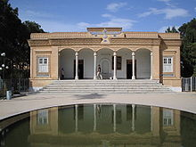
Impact of Zoroastrianism
200,000 worldwide
Influence on other religions
God vs. Satan
the Soul
Heaven & Hell
Virgin birth of savior
Resurrection
Day of Judgement

Slide 19
Judaism
Monotheistic
Yahweh (Yhwh)
Abraham considered “father” of the Jews
Hebrews are the chosen people of God & Canaan is the chosen land
Messiah will create God’s kingdom on Earth
Abraham and Issac by Rembrandt

Slide 20
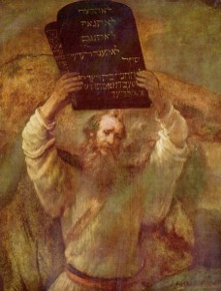
Basic Beliefs of Judaism
Death is not the end of human existence
Focus on life instead of afterlife
Believe dead will be physically resurrected
One is saved through commitment to being moral to God.
614 Rabbinical laws
Moses by Rembrandt

Slide 21
Social Impact of Judaism
Short lived kingdom in the Middle East
Jewish Diaspora
Heavy emphasis on tradition & culture
Language, diet, holidays, etc.
Patriarchal community
Matrilineal descent
Israel as a united monarchy lasted from 1050-930 BCE. Eventually it was divided into two kingdoms. The northern kingdom of Israel would last until 720 BCE. The southern kingdom of Judah would last until 586. The fall of the two kingdoms led to Jewish Diaspora.

Slide 22
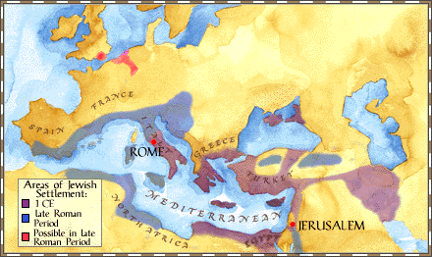
The Diaspora

Slide 23
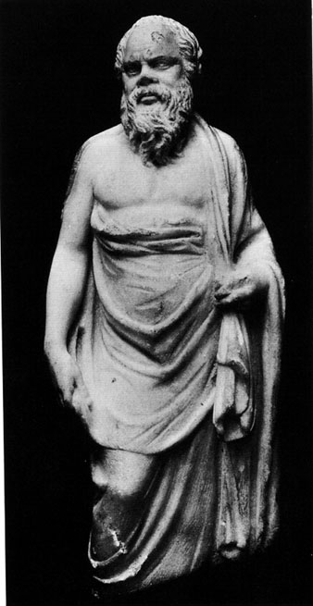
Greco-Roman Philosophy
Started 600 BCE
Most important philosophers were Socrates, Plato, and Aristotle
Goal: understanding the universe & human behavior
Socratic method
Argument & Reason
Spread throughout Mediterranean, Middle East, and North Africa

Slide 24
Basic Beliefs of Christianity
Founded by Jesus of Nazareth (c.6 BCE – c.30 CE)
Believed to be Son of God
Reform movement of Judaism
New covenant downplayed “the law”
Holy Trinity

Slide 25
Basic Beliefs of Christianity
Resurrection of the body and eternal life
Jesus crucifixion redeemed humans of their sins
Faith in Jesus allows one to enter heaven
Sacraments
Holidays

Slide 26
Social Impact of Christianity
Appealed to lower classes of Roman Empire
Created a new system of ethics
Formal church organization emerged in 1st/2nd century CE

Slide 27
Spread of Christianity

Slide 28
The Expansion of Civilization

Slide 29
Model of Empire
According to historian Conrad Demarest, empires have four stages…
Preconditions for the rise of an empire
The building of the empire
Rewards of the empire
Fall of the empire

Slide 30
What is needed to build an empire?
State level government
High agricultural potential of area
An environmental mosaic
Several small states with no clear dominant state (power vacuum)
Mutual antagonism between local states
Adequate military resources

Slide 31
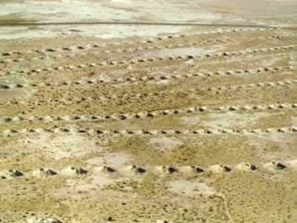
Qanats

Slide 32
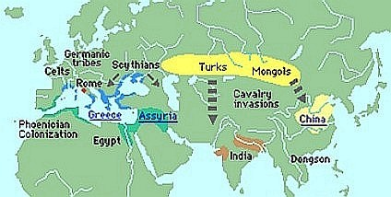
The World: 600 B.C.E.

Slide 33
How do you build an empire?
The primary reason a state succeeded in empire building was an ideology supporting personal identification with the state, empire, conquest, and militarism

Slide 34
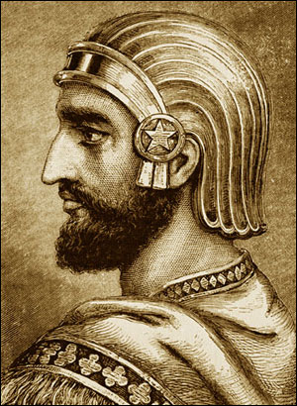
Cyrus the Great
Created the Persian Empire (550-539 BCE)
Conquered Babylon
Used kindness and tolerance to rule conquered peoples
Viewed by Jews as a liberator
Allowed Jews to return to their homeland

Slide 35
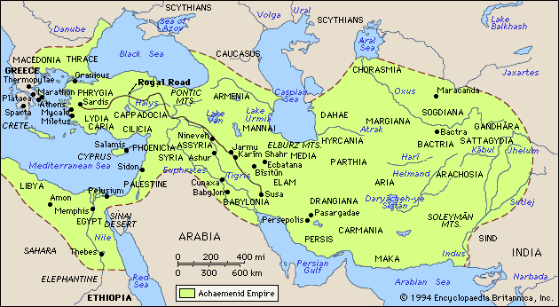
Persian Empire in 525 BCE

Slide 36
What are the rewards of empire?
Stable government with a bureaucracy
Large military
Creates peace for citizens near the core
Infrastructure
Roads, bridges, irrigation, etc.
Cultural Development
Architecture, literature, science, etc.

Slide 37
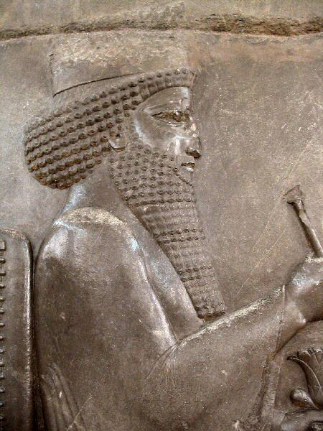
Darius the Great
Ruled 522-486 BCE
Administrative Genius
Provinces & Satraps
Built the Royal Road
Used metal coins
1st government to use standard currency
Zoroastrianism
Idea of Heaven & Hell

Slide 38
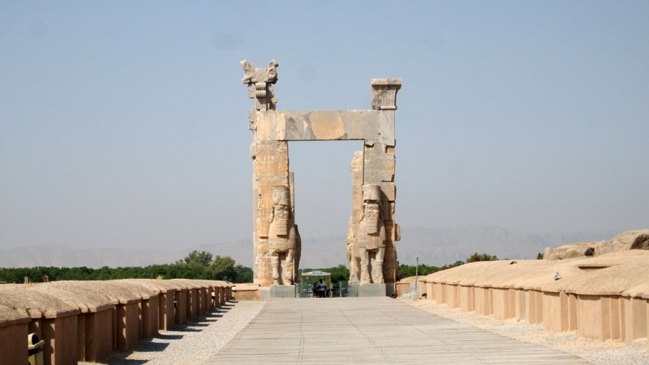
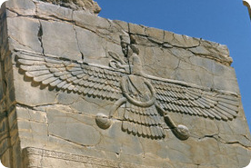
Persepolis

Slide 39
Why do empires collapse?
Two Reasons!
Internal Weakness
Rising economy = costly rewards
Declining economy = costly rewards
What rewards do you cut?
External Pressure
Empire was built at expense of its neighbors
Neighbors take advantage of internal weakness
Empires collapse from internal rebellion or external conquest

Slide 40
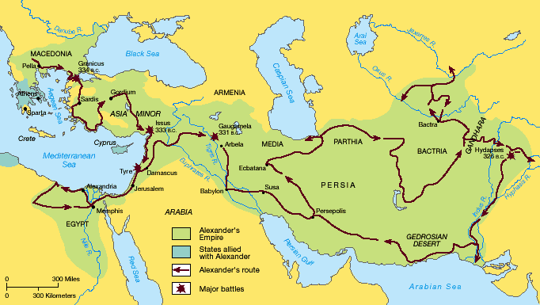
Alexander the Great

