Slide 1
(Long Essay Question) LEQ 101
Ms. Adcox

Slide 2
LEQ Rubric (Total 6 Points)
Contextualization (1 point)
Thesis (1 point)
Evidence (2 points)
Describes specific evidence in response to the prompt (at least 3 or more)
SUPPORTS your argument
Analysis and Reasoning (2 points)
Uses historical reasoning to structure argument (Comparison, Causation, CCOT)
Complex Understanding?

Slide 4
AP Exam LEQ
40 minutes
15% of Exam Score
Students will choose from 3 options
There is no page requirement
Grammar doesn’t count
Students must write in black or blue ink
LONGER IS NOT ALWAYS BETTER (BE CONCISE)

Slide 5
Comparison, Causation, CCOT

Slide 6
How to Tell an Aspen Tree (some of you write like this)

Slide 7
Audience Matters
You are HISTORIANS in this class, so you will need to write like one.
Be specific and explain everything, don’t assume your audience knows what you writing about.

Slide 8
Prompt
Compare the political and economic effects of Mongol rule on TWO of the following regions:
China
Middle East
Russia

Slide 9
Break Down Question
Compare the political and economic effects of Mongol rule on TWO of the following regions:
China
Middle East
Russia
Compare effects (pol/econ)
Mongols= time period= 13th century (1200s)

Slide 11
ALWAYS ALWAYS ALWAYS…ALWAYS PLAN
Which of those regions do you know the most about? PICK THEM
Diagram or List Planning (Venn, thinking web, exc.)

Slide 12
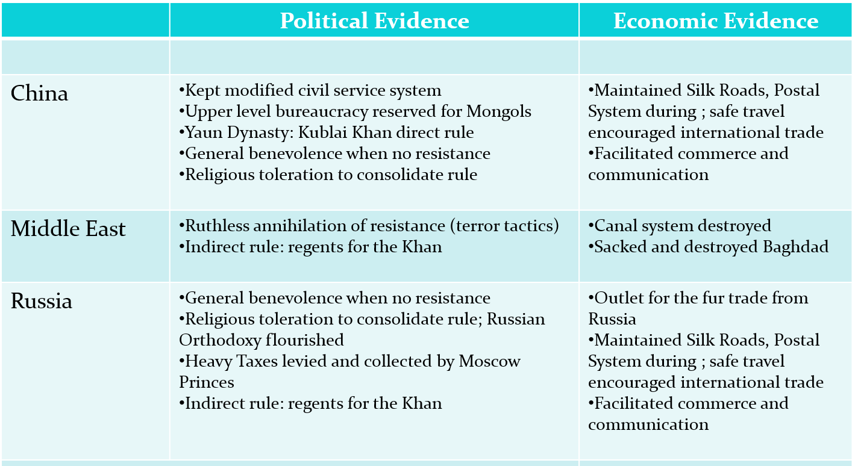

Slide 13
CHINA
Yuan Dynasty
RUSSIA
Golden Horde
POL
*Kept essential imperial structure (DIRECT RULE)
-Emperor (Kublai Khan)
-Bureaucracy: used Mongols/foreigners though, no civil service exam (ex. Muslims and Marco Polo)
ECON
*Taxed peasants directly
POL
*Didn’t occupy/ run Russian gov= local princes did and paid tribute to Mongols (INDIRECT RULE)
-Rise of Moscow and decline of Kiev (ex. Tver Uprising in 1327)
ECON
*Local princes collected taxes (levied very high taxes ☹)
Increased Eurasian trade (maintained Silk Roads)= Pax Mongolica
Mongols still #1 in government

Slide 14
Organize
Introduction (Contextualization and Thesis)
Body 1
Main Idea-
Specific Supporting Evidence-
Body 2
Main Idea-
Specific Supporting Evidence-
Body 3 (possible complex argument?)
Main Idea-
Specific Supporting Evidence-
Conclusion

Slide 15
Complexity Point? Going above and beyond prompt!

Slide 16
Contextualization (What is it?)

Slide 18
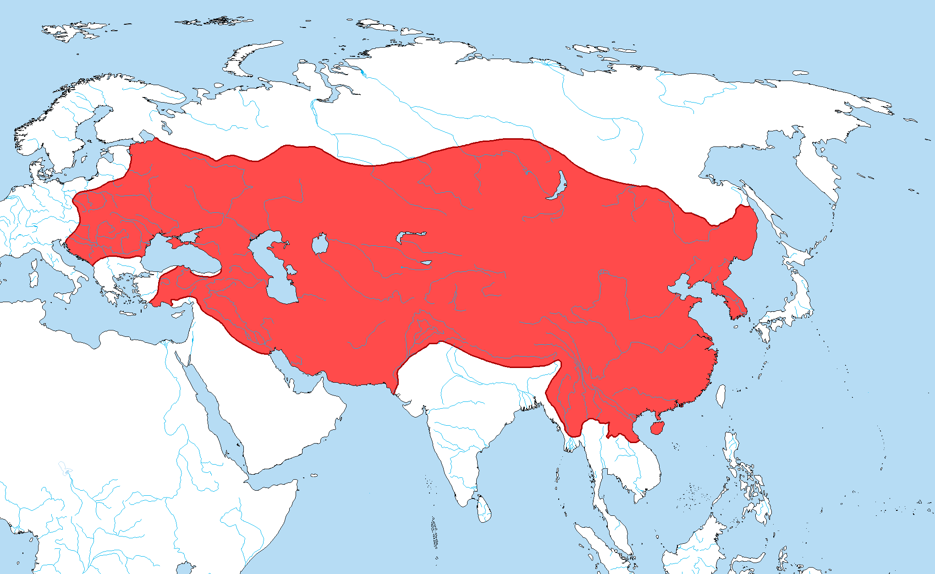
Mongols: What do we know?

Slide 19
Contextualization (more than just a phrase or reference!)
What events influenced your prompt?
Mongol Empire established under Genghis Khan→ Largest contiguous land-based empire in world → Mongols dominated 13th century Eurasia
Genghis Khan died 1227 → Left huge empire behind with diverse populations→ Split into 4 khanates led by descendants (ruled very differently from one another)

Slide 20
Contextualize (Write your introduction)
Introduction Paragraph Expectations: contextualize (3-4 sentences) and end with your thesis statement in the first paragraph of your essay
You will need to repeat this step in your conclusion

Slide 21
What is a thesis? Why is it so important?

Slide 22
Thesis
To earn this point, the thesis must make a claim that responds to the prompt, rather than merely restating the prompt.
There are no right or wrong answers, just well supported arguments and poorly supported arguments.

Slide 23
Don’t Let Your Thesis Be Feces Checklist
1. Answer the FULL question!
2. STAY IN THE TIME PERIOD (18th century= 1700s)
3. State directly (use the language of the prompt)
4. Have categories (don’t be vague)
Use specific SPICE themes
economic→ taxes; governance → bureaucratic administrations; social→ gender roles
5. Make an argument but acknowledge the other side.
You need a clear organized argument
Someone somewhere in the world has to read your thesis and be able to say “Yeah, I don’t agree”
Being a 1, 5, or 10 is a bad idea. Choose a side, but be willing to acknowledge the other sides of the issue
Address the counter argument (complexity) otherwise its just propaganda

Slide 24
Roadmap
STICK TO YOUR THESIS IN YOUR ESSAY!!!
ALL evidence used in your essay should be used to support your thesis

Slide 25
Thesis Formulas
1.) Y because A and B.
2.) X. However, Y because A and B.
3.) Although X, Y because of A and B.
X= Counterargument
Y= Your argument
A= Evidence/Group #1
B= Evidence/Group #2

Slide 26
Write your own thesis now (5 minutes)
Compare the political and economic effects of Mongol rule on TWO of the following regions:
China
Middle East
Russia

Slide 27
Poor Thesis (NO POINT ☹)
1. The Mongols affected China and Russia similarly and differently.
2. The Mongols greatly affected China and the Middle East.
3. The Mongols affected the Middle East and Russia in similar ways.

Slide 28
Acceptable
The political and economic effects of Mongol rule vastly differed in China and Russia because of Mongol direct/indirect control and systems of taxation.

Slide 29
Better
Although both regions experienced increased Eurasian trade, China was affected more, being ruled directly by Mongols, whereas Russia was largely left to its own devices under independent princedoms and felt Mongol influence largely via taxes.

Slide 30
Much Better/ More Complex
While the Mongols’ political influence in China was more dramatic in the short term, the Mongols actually influenced China less than they did Russia, which labored under a longer (if less obvious) Mongol influence for centuries. Economically though, the Mongols had a far reaching impact on both Russia and China because of their support for Eurasian trade.

Slide 31
Body Paragraphs
ACES
Assert/Top Sentence
Cite SPECIFIC Evidence
Explain Evidence
Significance to your thesis/argument

