Slide 1
Medieval & Renaissance Art
Art is reflective of the historical setting
Characteristics of Medieval Art
Different Mediums
Byzantine Icons
Characteristics of Renaissance Art
Early Italian Renaissance
Northern Renaissance
High Renaissance

Slide 2
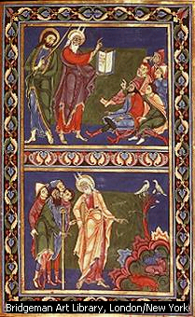
Characteristics of Medieval Art
Lacks depth or perspective
Figures are stiff and elongated
Facial expressions lack emotions
Background frequently a solid color with tempra

Slide 3
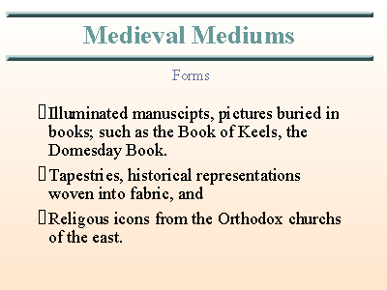

Slide 4
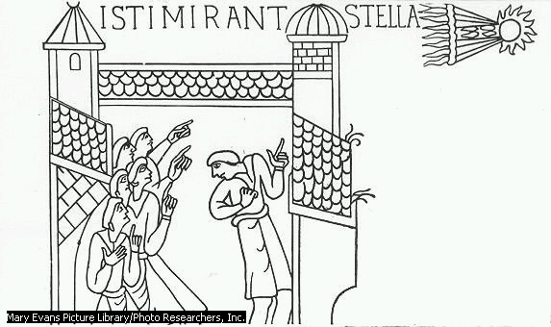
Bayeaux Tapestry
11th Century-Halley’s Comet

Slide 5
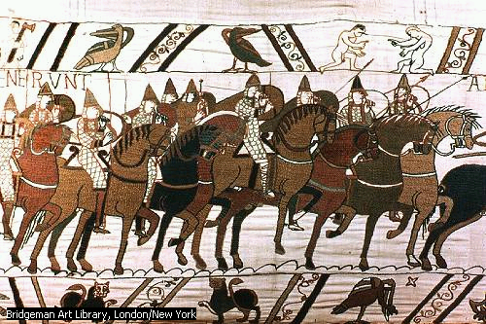
Bayeaux Tapestry
1066AD Battle of Hastings

Slide 6
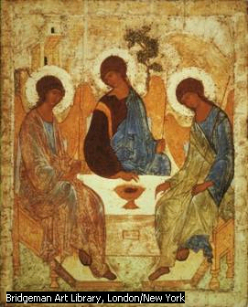
Byzantine Icon
9th Century

Slide 7
Characteristics of
Renaissance Art
Individualism-Emphasized the uniqueness of each face and figure with emotions.
Balance and Proportion-More realistic, tried to make art imitate life.
Perspective- The impression of depth and distance.
New Materials- Developed oil painting technique, create new colors and textures.

Slide 8
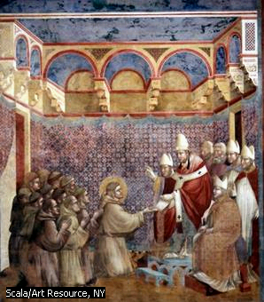
Giotto 1267-1337
St Francis Fresco Cycle
First use of Chiarascuro(light and shadow)

Slide 9
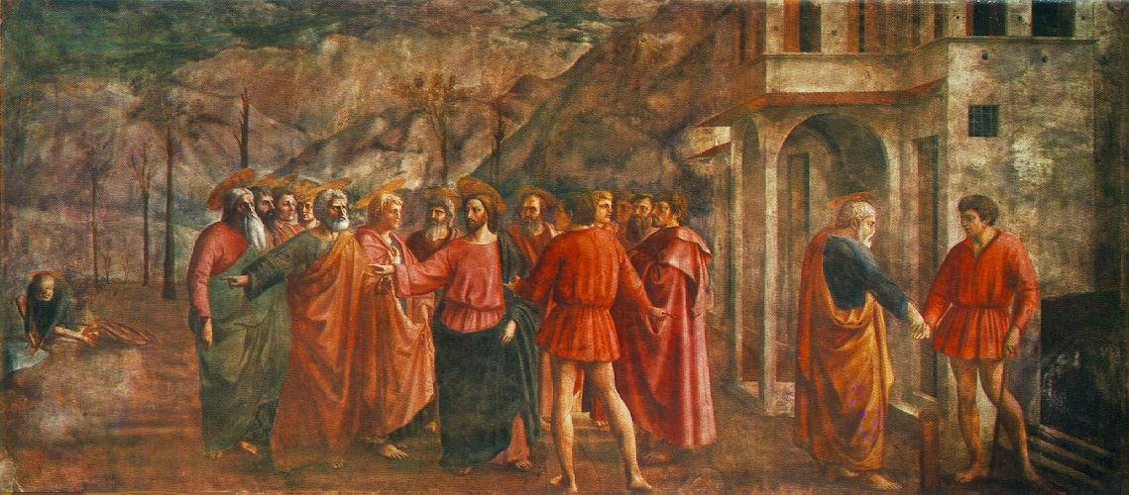
Masaccio’s The Tribute Money 1427 First use of linear perspective.

Slide 10
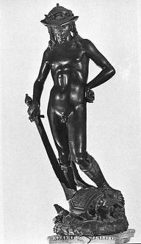
Donatello’s David 1440
First large cast bronze

Slide 11
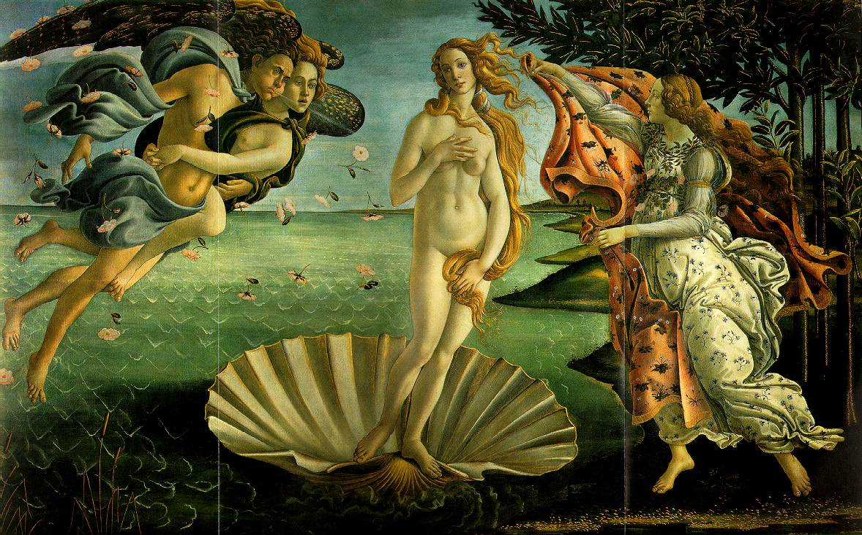
Botticelli’s Birth of Venus 1480
Neoplatonism, return to mythology

Slide 12
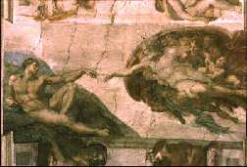
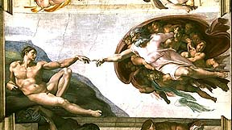
Michelangelo Buonarrati

Slide 13
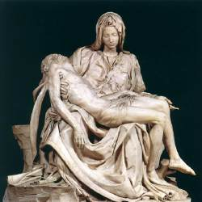
Pieta 1498-1500

Slide 14
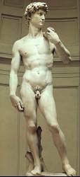
David 1501-1504

Slide 15
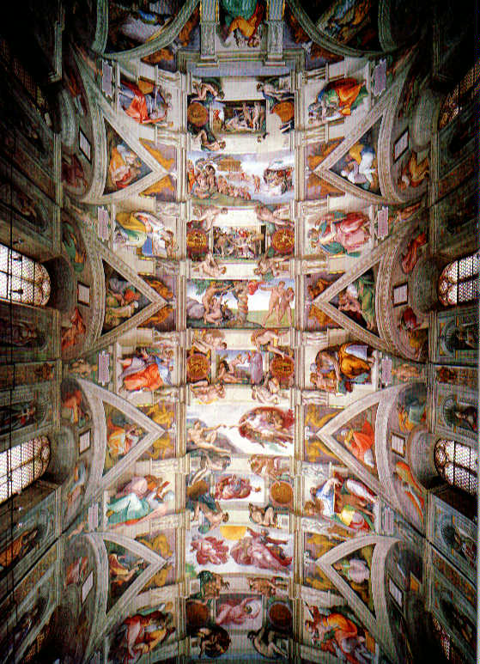
Sistine Chapel Ceiling 1512-1518
Four years working on his back

Slide 16
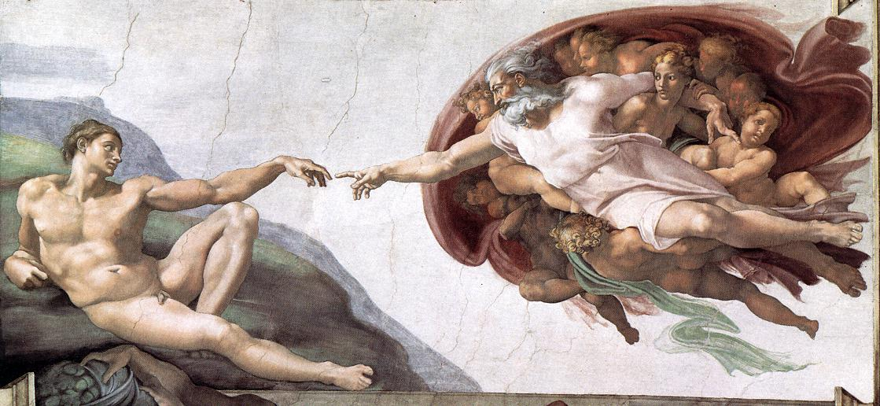
Creation of Adam from Sistine Chapel

Slide 17
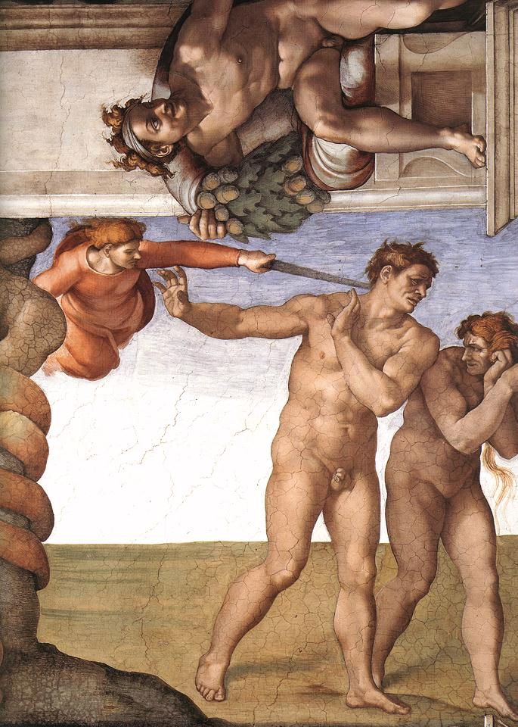
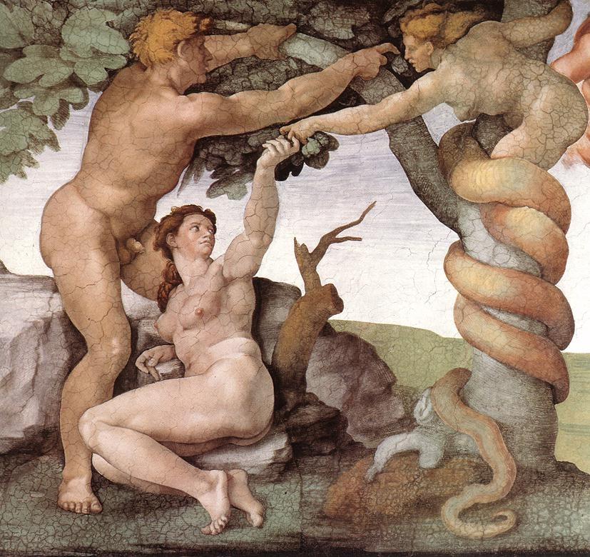
Temptation and Fall from Paradise from Sistine Chapel

Slide 18
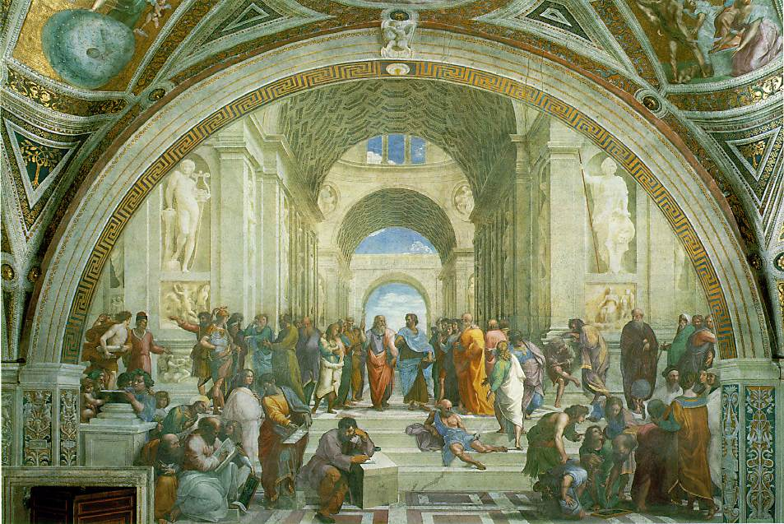
Raphael’s School of Athens 1510
Master of design and perspective

Slide 19
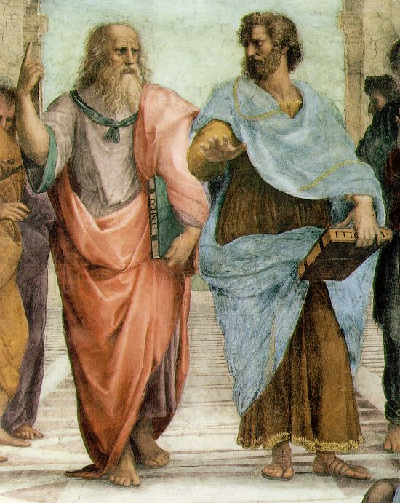
School of Athens-detail

Slide 20
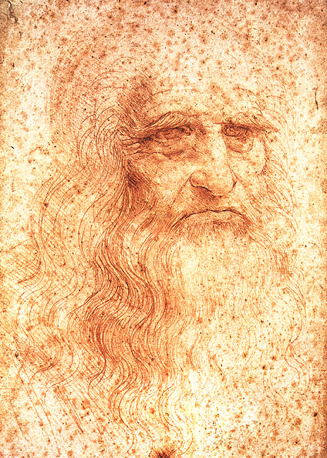
Leonardo da Vinci 1452-1519
Ideal Renaissance Man

Slide 21
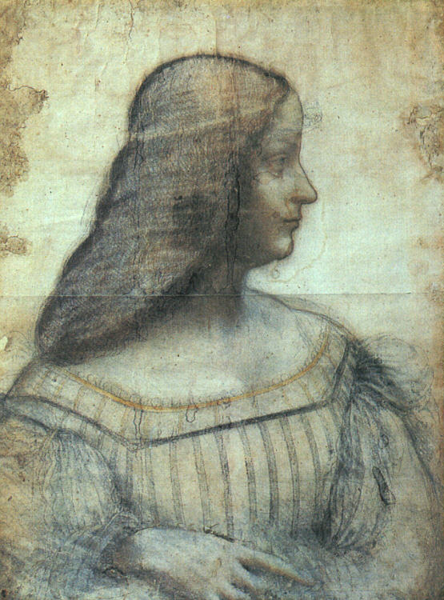
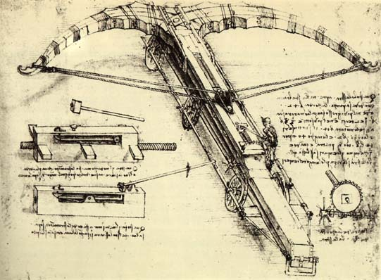
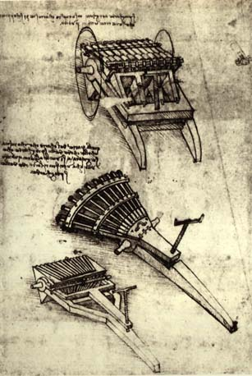
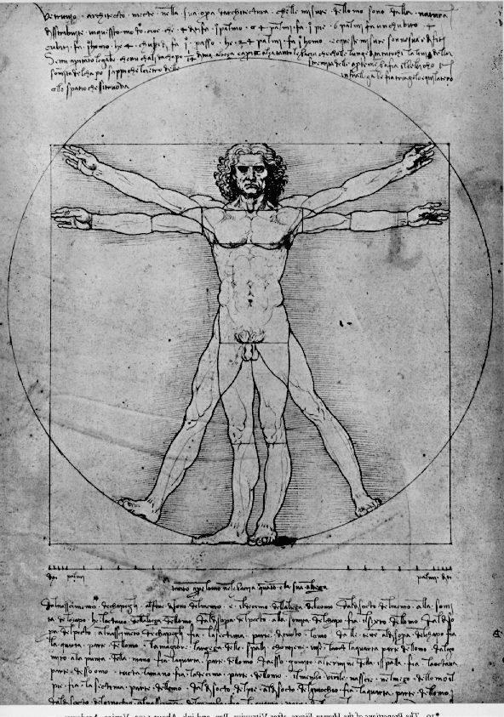
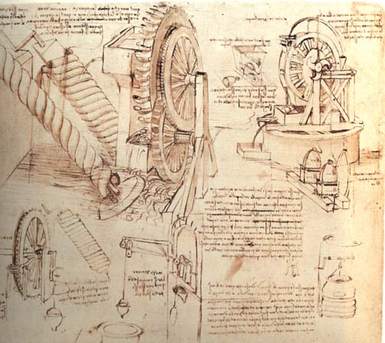
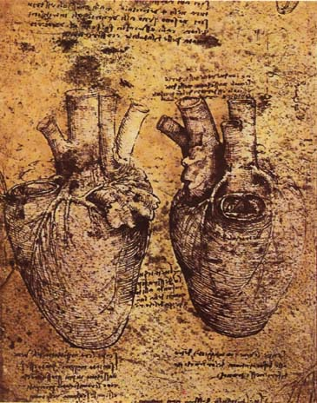
Studies from his notebook

Slide 22
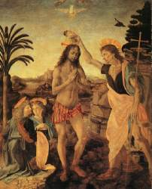
First work with Verrocchio
1472

Slide 23
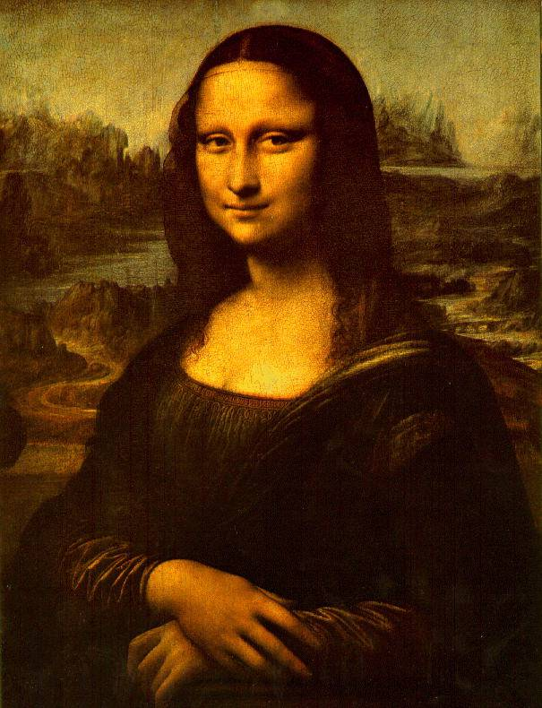
Mona Lisa(La Gioconda)1503
First use of sfumato

Slide 24
Northern Renaissance
Renaissance spirit catching on in the Northern European cities.
Renaissance ideas spread through trade and development of Guttenberg’s moveable type.
New innovations in artistic style arise.

Slide 25
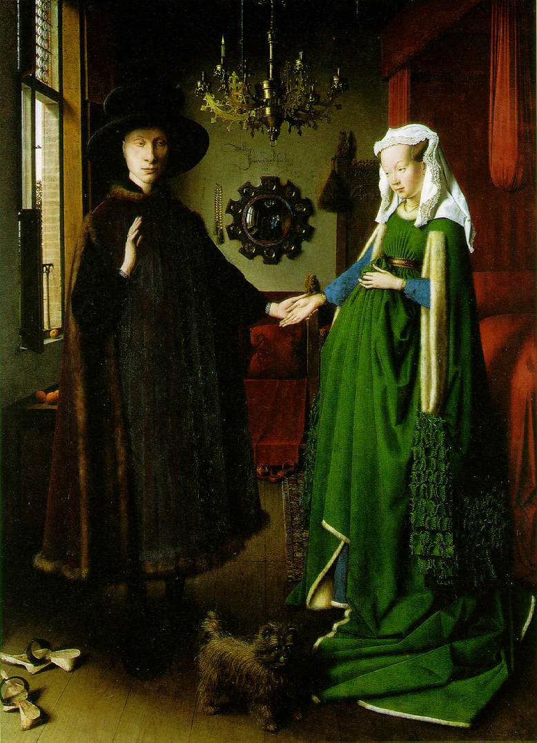
Jan Van Eyke’s Arnolfini Wedding1430
First use of oil based paints

Slide 26
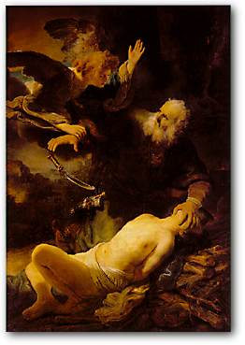
Rembrandt’s Abraham and Isaac 1634
Dutch artist famous for use of light and shadow.

Slide 27
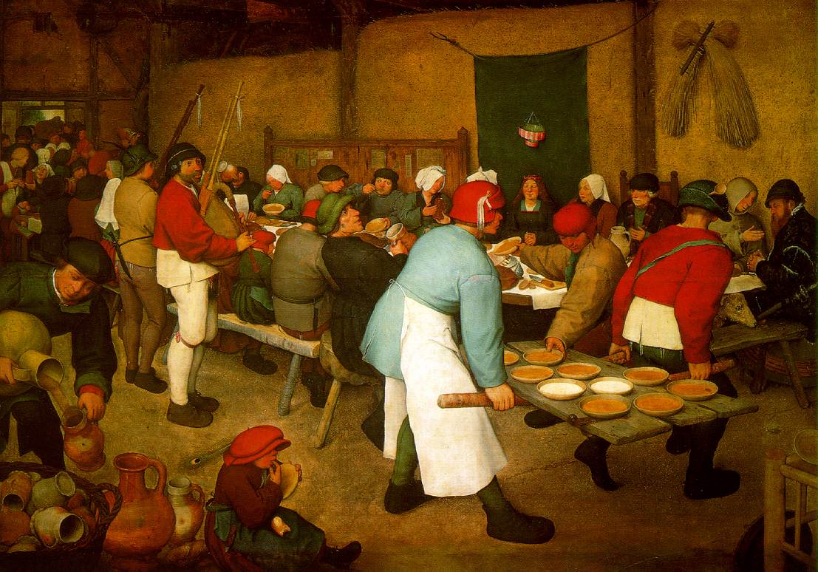
Pietre Brueghel’s Peasant Wedding
Famous for scenes of everyday life

Slide 28
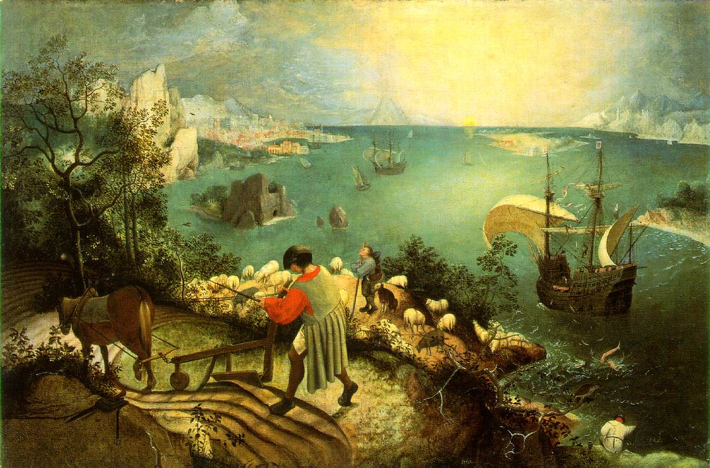
Brueghel’s The Fall of Icarus 1558

Slide 29
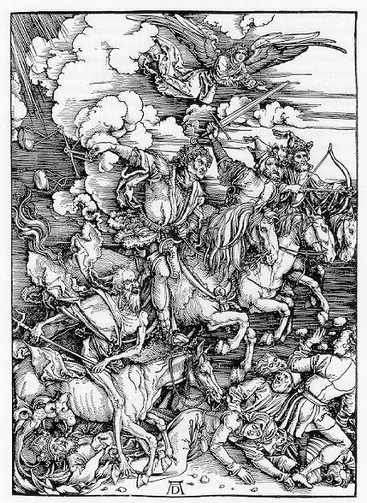
Albrecht Durer’s Four Horsemen 1498
First Artist to sign his work. Woodcut

Slide 30
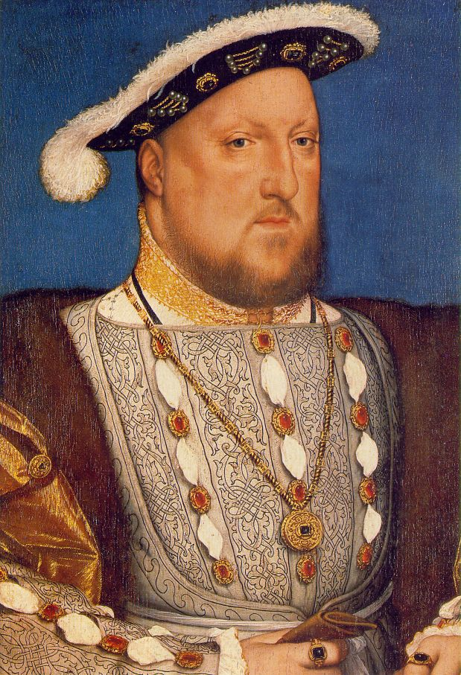
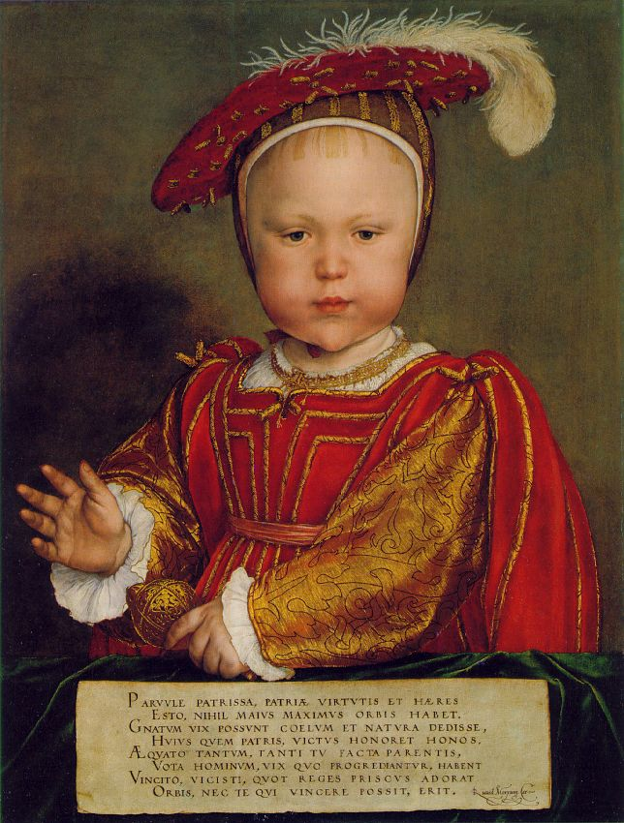
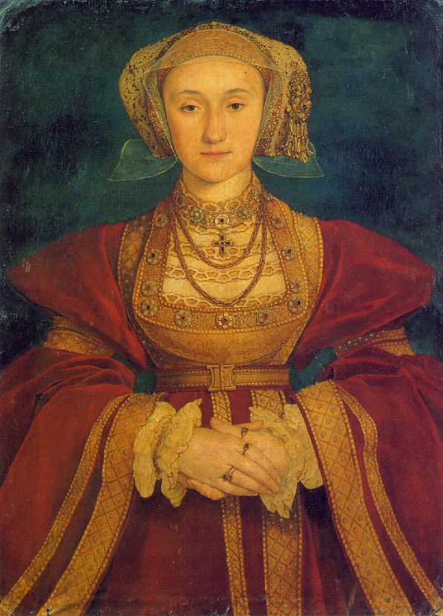
Hans Holbein’s Portraits 1536-1540
German Born, Most famous portrait painter

Slide 31
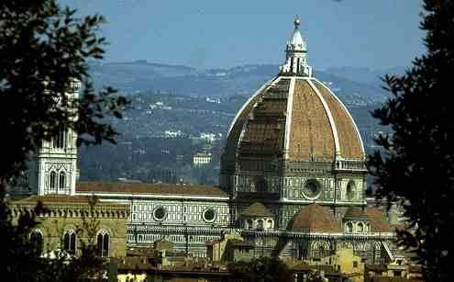
Brunelleschi’s Dome in Florence , 1420-1436

