Slide 1
Islam Foundations

Slide 2
Islam?
Why do you think we know so little about Islam?

Slide 3
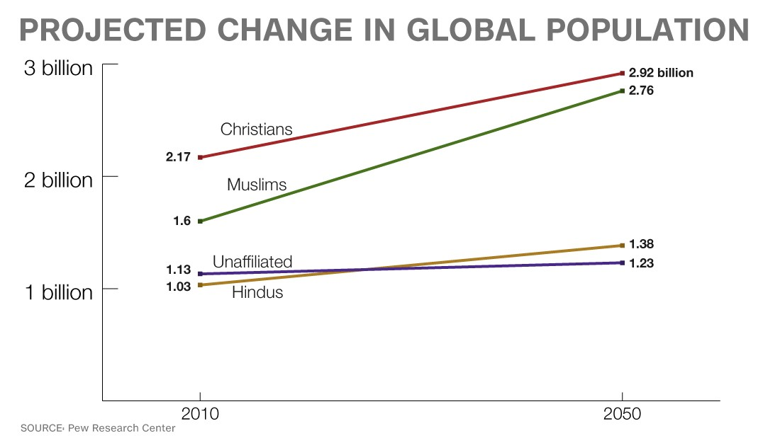
Significance
In less than 200 years, Islam went from not existing to being the religious and political backbone for some of the world’s largest empires.
World’s 2nd largest religion (1.8 billion followers= 24.1% of global population)
Muslims make up a majority of the population in 50 countries
It is the fastest-growing religion in the world

Slide 4
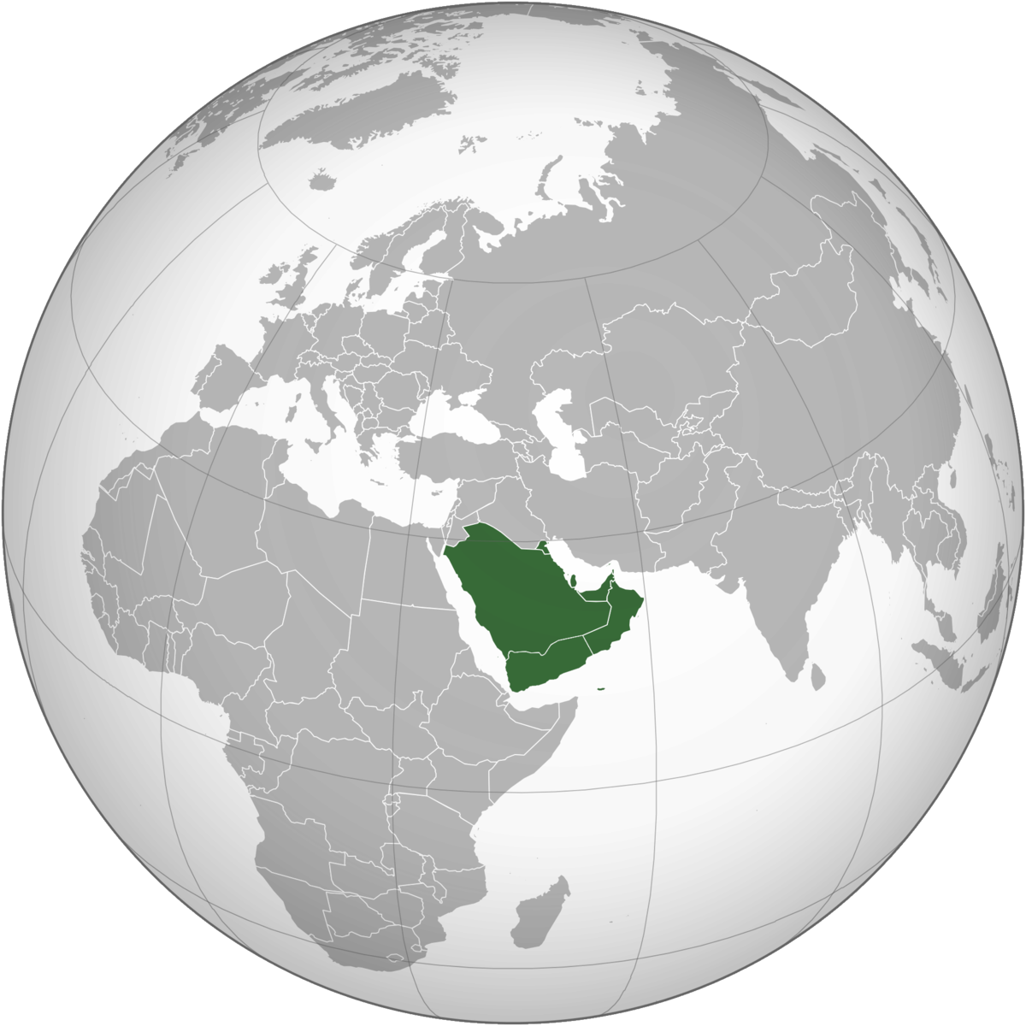
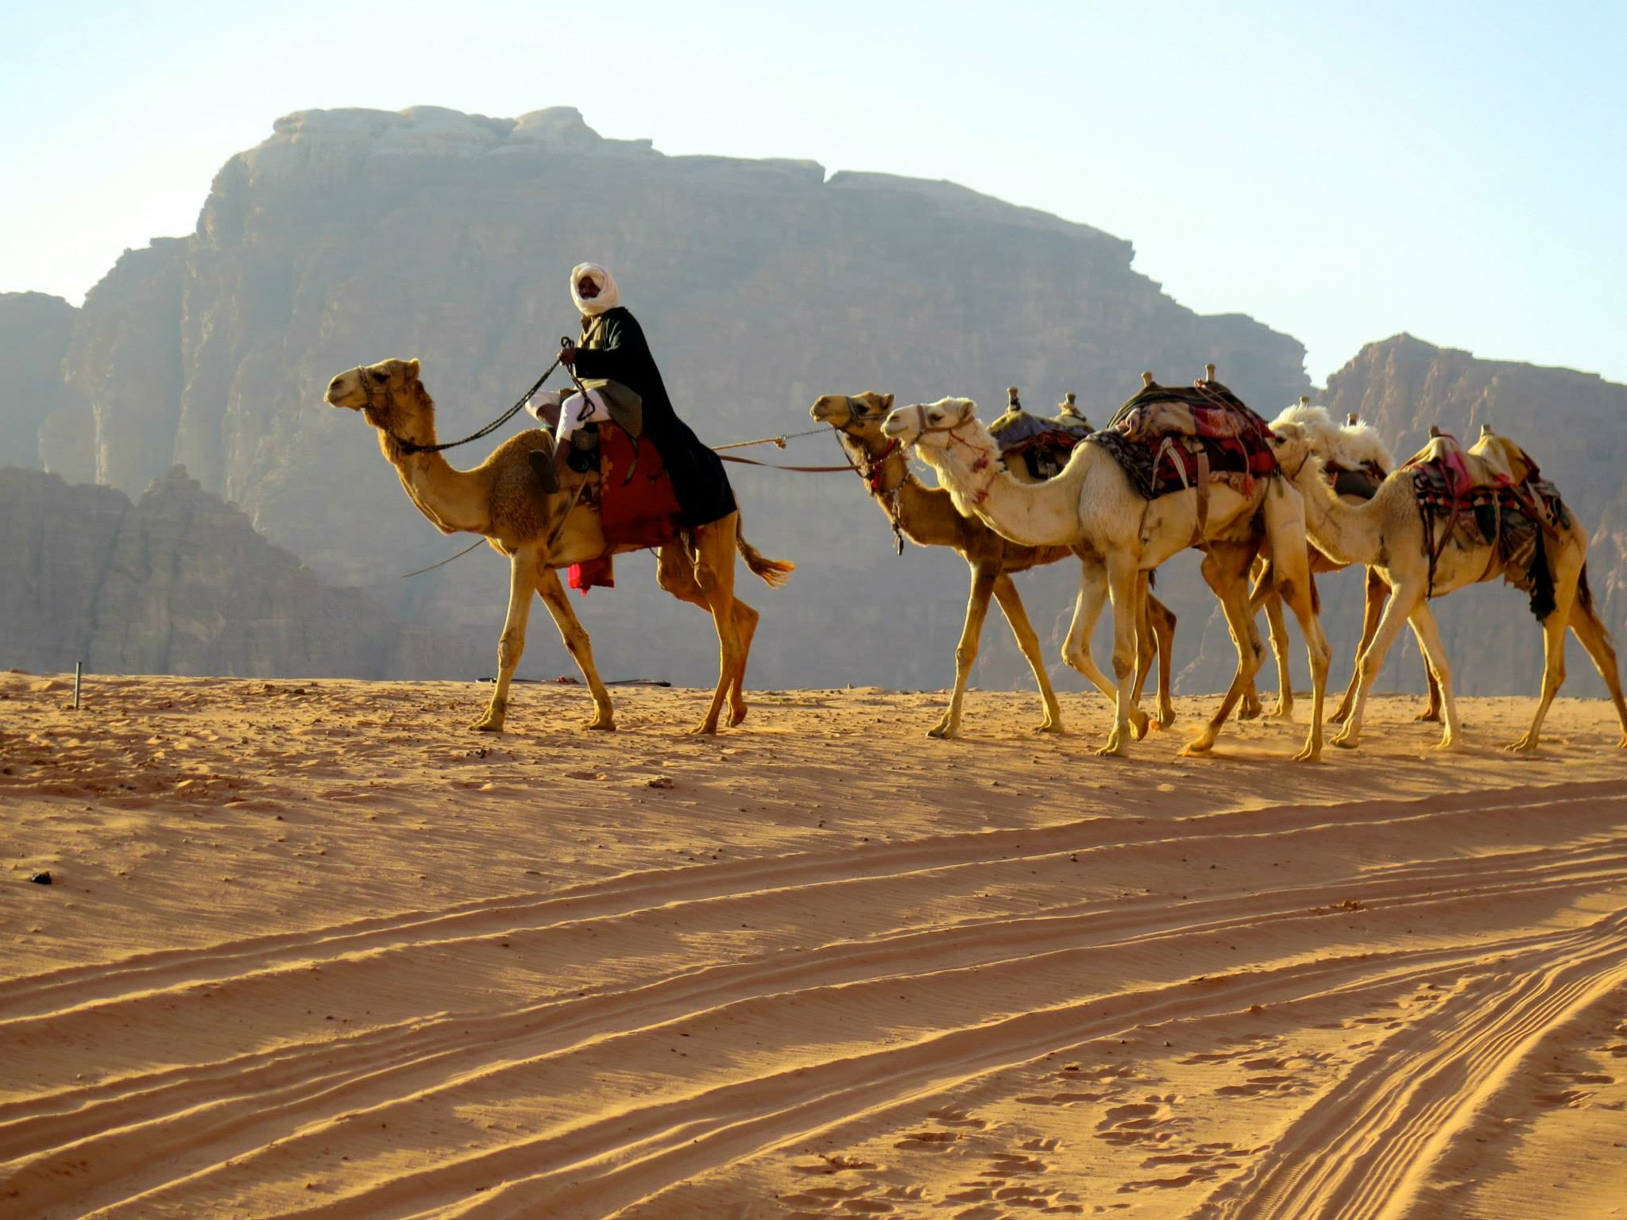
Pre-Islamic Culture
In the 6th century (500s CE), the Bedouins were well established in the Arabian Peninsula.
Culture: nomadic, pastoralists, tribal, polytheistic
Tribal ties extremely important and region seen as a religious melting pot
Land trade routes via camels formed the basis of the Arabian economy

Slide 5
Byzantine vs. Sassanid Empires
Sassanid (last kingdom of the Persian Empire before the rise of Islam)
Sassanid= Zoroastrian faith
Byzantine= Christianity
One god (monotheism) not surprising concept (unlike Abraham)
Arabia sandwiched between Byzantine and Sassanid Empires
Both empires always at war with each other

Slide 6
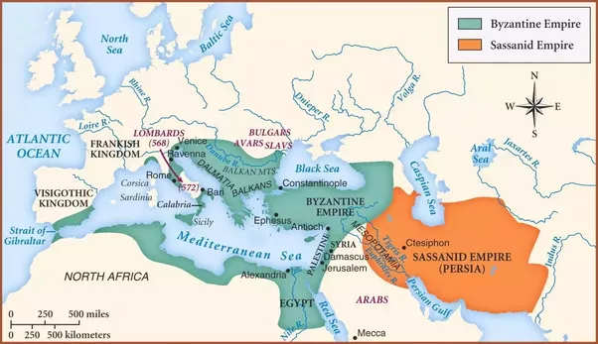

Slide 7
Mecca
Mecca became blooming caravan city

Slide 8
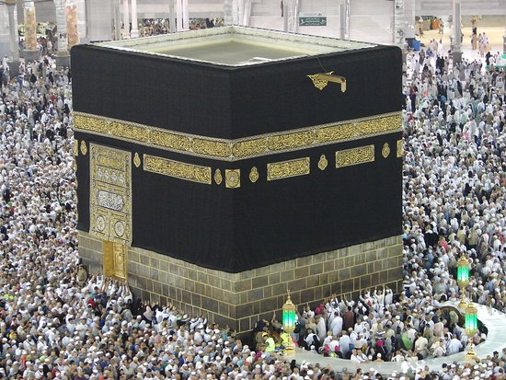
Kaaba
Temple like structure (statues of gods collected) in Mecca

Slide 9
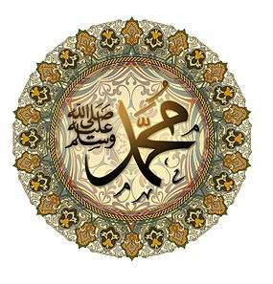
Muhammad
Muhammad was born into the Bedouin world in 570 CE
Hometown: Mecca
Engaged in caravan trade
Around 610 CE, Muhammad began meditating at night→ encountered angel Gabriel who spoke to him→ Muhammad shared these revelations and his conviction that he was hearing the words of God with close friends/family

Slide 10
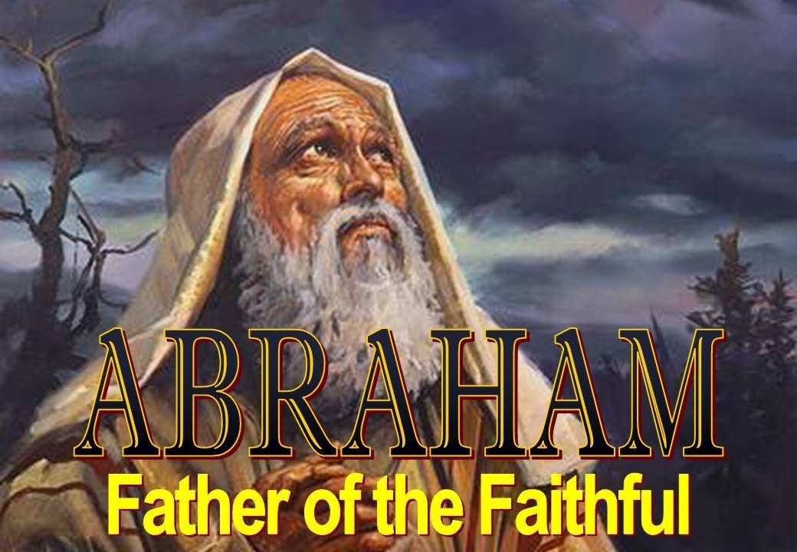
Muslims
Muhammad final prophet (DO NOT WORSHIP AS DIVINE THOUGH)
Required worship and submission to the one true God (Allah)
Noah, Mosses, and Jesus were prophets (easy for people to connect his message with Judaism and Christianity which many were familiar with)
Slowly at first, Muhammad’s ideas spread through his preachings (3 years= 30 followers)

Slide 11
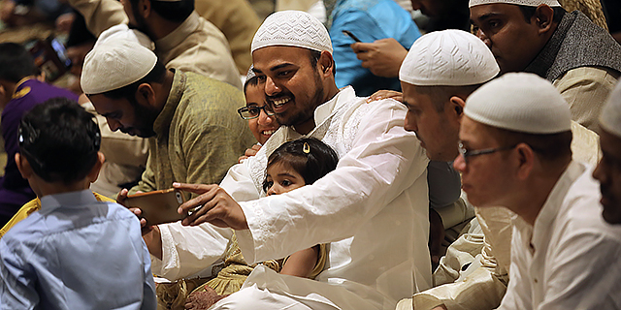
Umma (Ummah)
Community of all Muslims
A major innovation against the background of 7th century Arabia, where traditionally kinship rather than faith had determined membership in a community (tribal ties!)

Slide 12
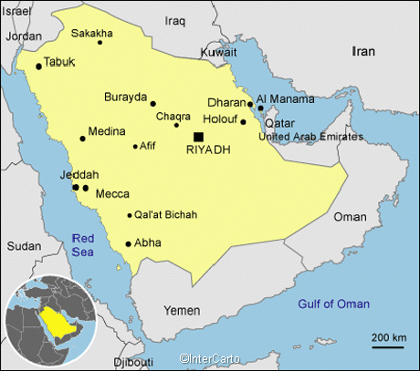
Umma (Ummah)
This community of believers trumped tribal ties and raised suspensions
Got attention of Quraysh tribe (might be economic disaster?)
Forced Muhammad and Ummah out of Mecca in 622 CE→ traveled to Medina

Slide 13
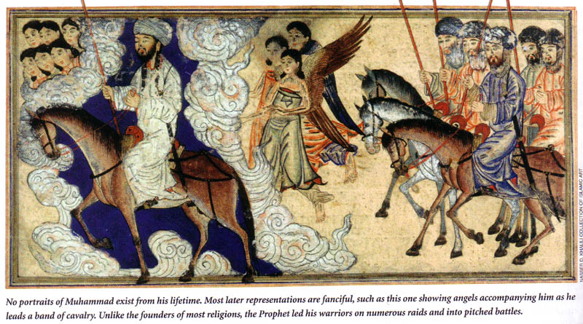
Medina
Small empire rather than church?
Muhammad was an important prophet, but also a really good general
630 CE Islamic community took back Mecca and destroyed idols in Kaaba
632 CE Muhammad died

Slide 14
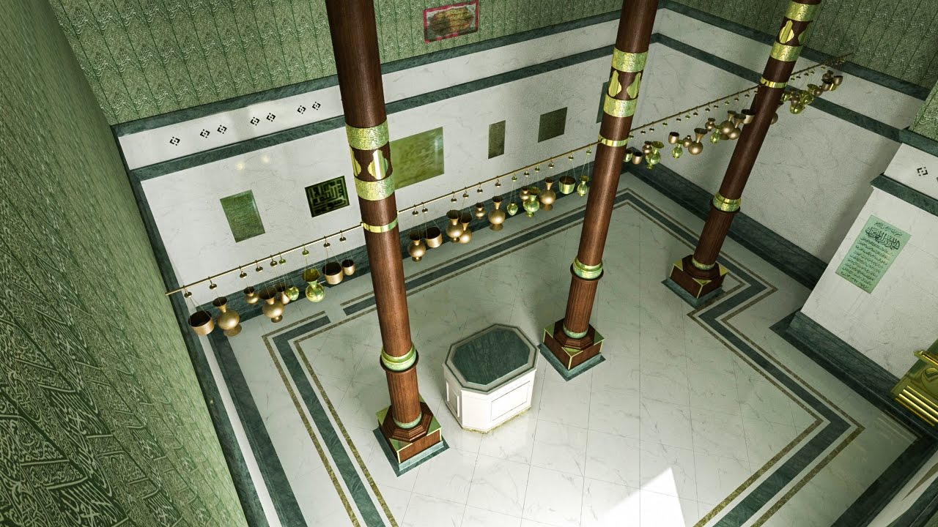
Kaaba
After returning to Mecca, Muhammad declared the cube shaped building
Major shrine of Islam
The Quran contains several verses regarding the origin of the Kaaba, it states that the Kaaba was the first house of worship, and that it was built by Abraham and Ishmael (his son) on Allah's instructions.
Houses scared black stone

Slide 15
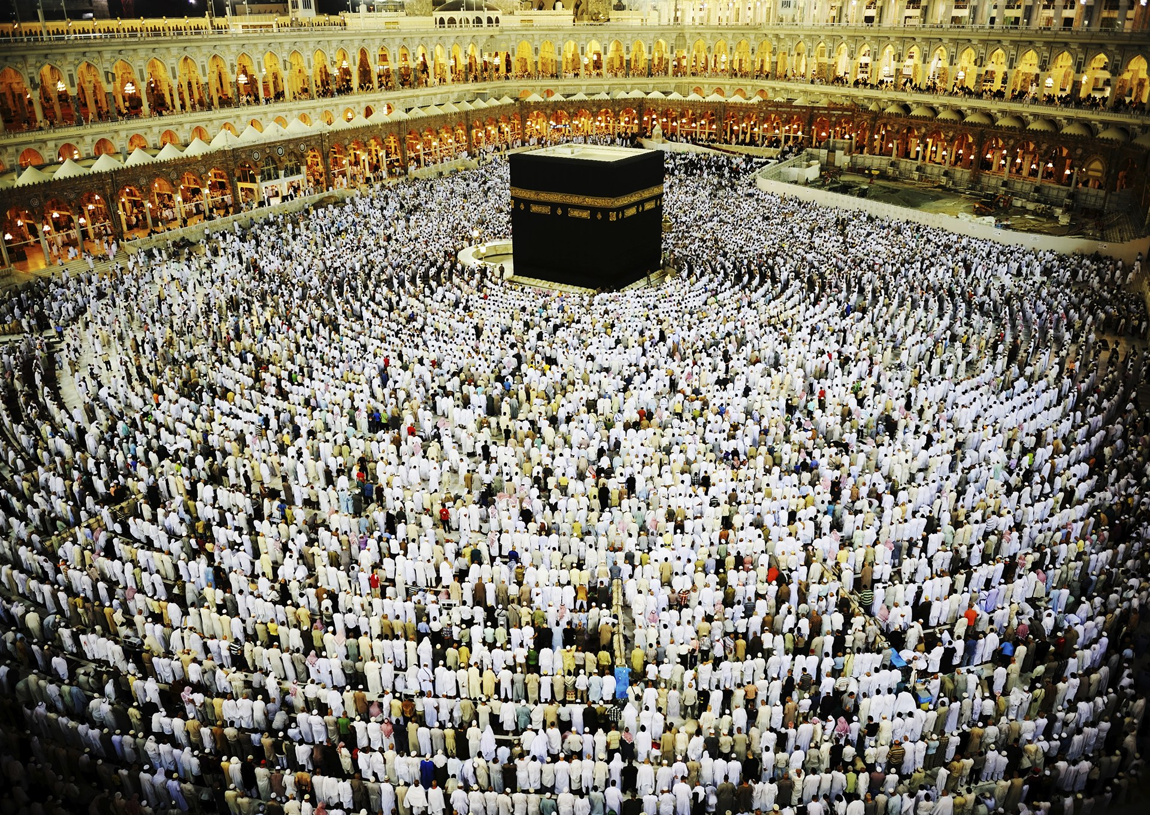
Kaaba
After returning to Mecca, Muhammad declared the cube shaped building
Major shrine of Islam
Houses scared black stone

Slide 16
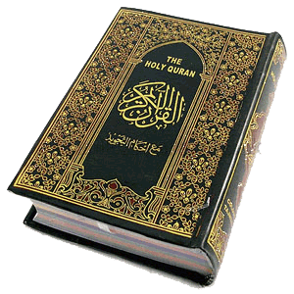
Quran
Book composed of divine revelations made to the Prophet Muhammad between 610 and his death in 632; the sacred text of Islam
Verbatim word of God
The Quran vs. the Bible?

Slide 17
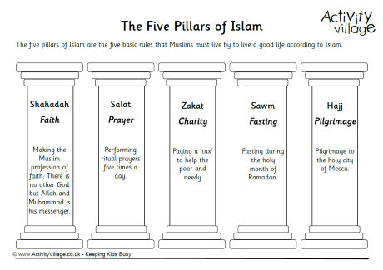
Core Theological Principles: 5 Pillars
Monotheistic faith
Salvation and hope of an afterlife; the importance of submission to the will of Allah (the one true God), and a belief in the Quran as the sacred book providing guidance and laws for the followers

Slide 18
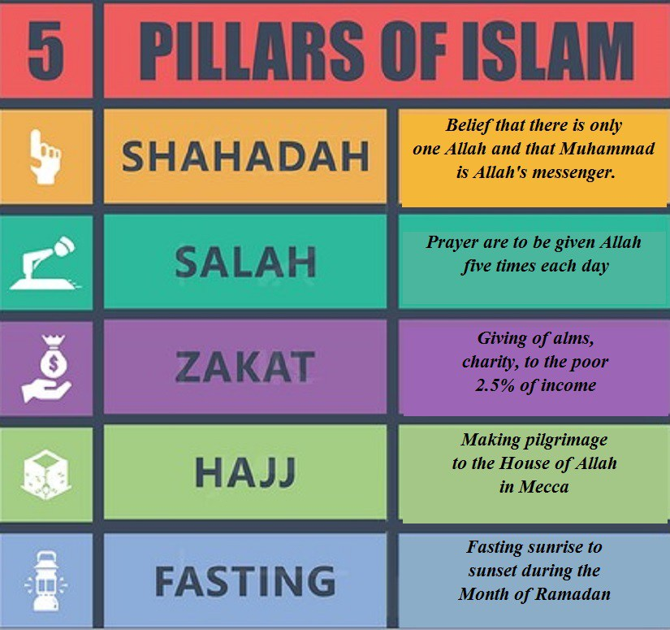
Jerusalem
Oral rather than written tradition (problem for history?)

Slide 19
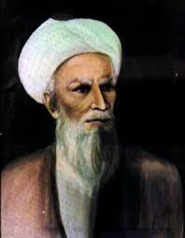
Succession to Muhammad
Muhammad was final prophet, but community still needed a political leader
Abu Bakr (1st caliph) (father in law and friend)
Caliph: religious successor to Islamic prophet Muhammad and the leader of the entire ummah
Dynastic hereditary rule
Abu Bakr stabilized community after Muhammad’s death, began process of recording Quran in writing, and led successful military campaigns against Byzantine and Sassanid Empires
Tradition of conquest and assassination?

Slide 20
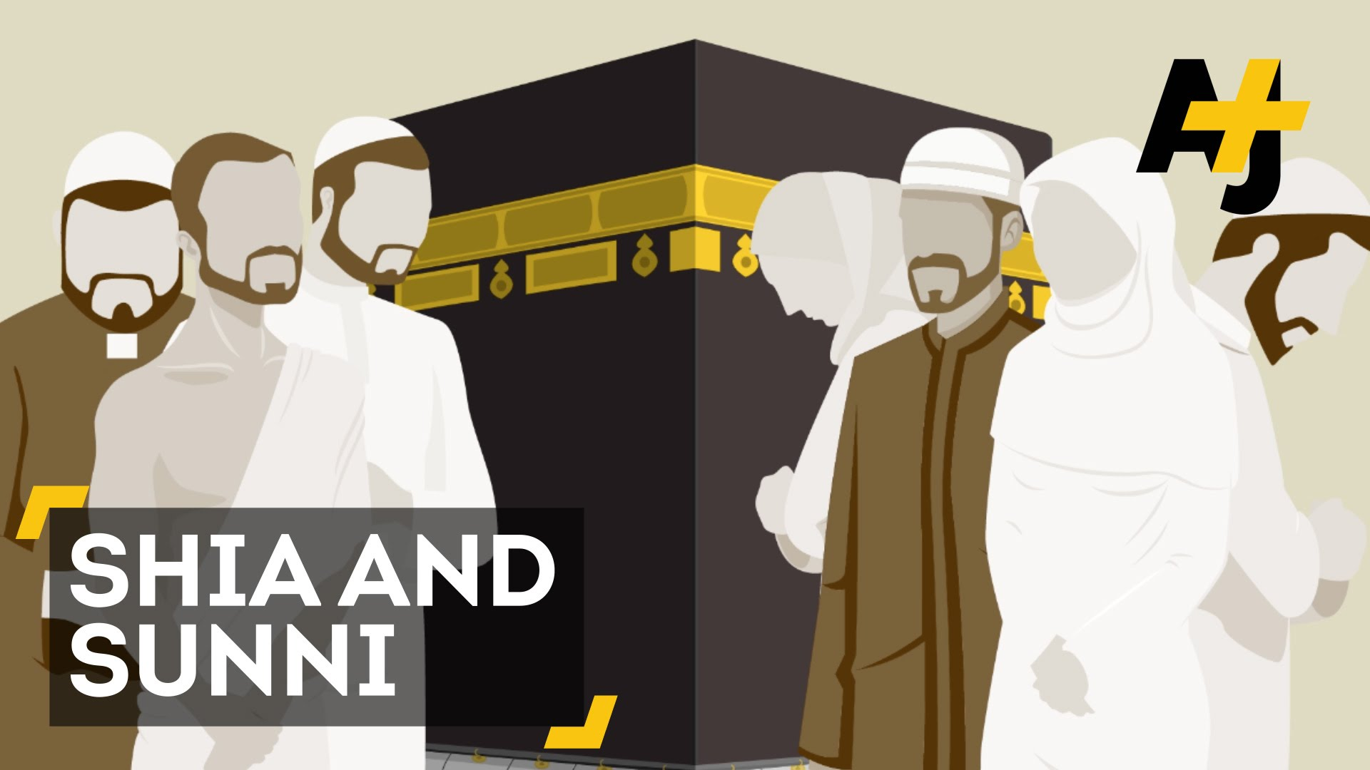
Sunnis vs. Shia (Shi’ites)
Sunni (75-90%) → Abu Bakr → Muhammad not clearly designate a successor and Muslim community elected
Shia (Shi’ites) (10-20%) → Ali (1st cousin, son in law) → Muhammad choose Ali as successor at the event of Ghadir Khumm (from same clan)
Results in First Muslim Civil War (661 CE)
DISAGREEMENT OVER SUCCESSOR= 2 DENOMINATIONS
Mu’awiya (kinsman of the assassinated Uthman) emerges as winner→ son forms Umayyad Caliphate

Slide 21
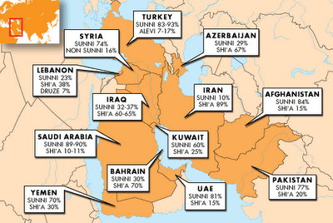
Sunnis vs. Shia (Shi’ites)
Sunni (75-90%) → Abu Bakr → Muhammad not clearly designate a successor and Muslim community elected
Shia (Shi’ites) (10-20%) → Ali (1st cousin, son in law) → Muhammad choose Ali as successor at the event of Ghadir Khumm (from same clan)
Results in First Muslim Civil War (661 CE)
DISAGREEMENT OVER SUCCESSOR= 2 DENOMINATIONS
Mu’awiya (kinsman of the assassinated Uthman) emerges as winner→ son forms Umayyad Caliphate

Slide 22
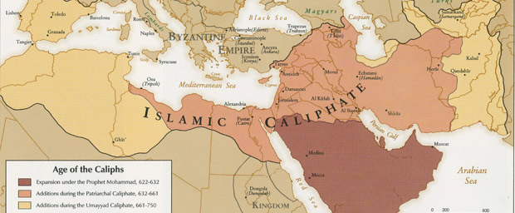
Caliphates
Islamic multi-ethnic trans-national empires
1st Rashidun (632-661 CE)
2nd Umayyad → Damascus (Syria) (661-750 CE)
3rd Abbasid → Baghdad (Iraq) (Golden Age of Islam)→ Mongols ☹ (750-1258 CE)
4th Ottoman

Slide 23
Islam Expands
Early Islamic empires really good at winning wars (Sassanid too weak anyway)
Arab conquests outside of Arabia began under the second caliph (Umar 634-644)) = Egypt, Syria, Tunisia, and Spain
Quran states religion should not be an act of compulsion
Many people embraced Islam without any military campaigns
Stunning military successes convinced people/lower taxes to converts
Converting to Islam equaled prestige and access (commercial connection)
Jizya (non-Muslim tax)

Slide 24
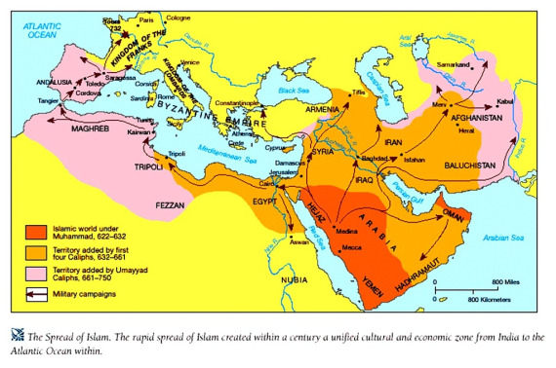

Slide 25
Al-Andalus/ Caliphate of Córdoba
Muslim-ruled area in the Iberian Peninsula (now Spain and Portugal) between 711 until 1492 with the Christian Reconquista.
Was a major center of learning (advancements in trigonometry, astronomy, surgery, and pharmacology)
Muslims and non-Muslims often came from abroad to study at the libraries and universities
The city of Córdoba, the second largest in Europe, became one of the leading cultural and economic centers= conduit for cultural and scientific exchange between Islamic and Christian world
Tolerant of other faiths: Christians and Jews were subject to a special tax called jizya, but were provided autonomy and equal protection. Peaceful coexistence led to their economic and social expansion.

Slide 26
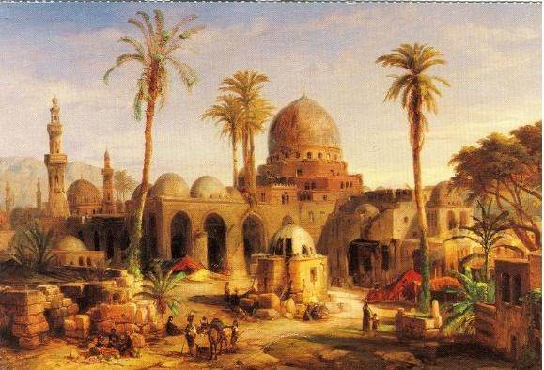
Abbasid Caliphate
Abbasid Caliphate became one of the most powerful and innovative empires of its time
City of Baghdad and the “Golden Age of Learning”: explosion of trade, better print-making process and center of science/culture/philosophy
Persian bureaucrats- Persians were able to convert to Islam while maintaining their distinctive Persian culture and language
Decline: new Islamic political entities emerged, most of which were dominated by Turkic peoples (Mamluks and Seljuk Turks)
Fell in 1258 when Mongols destroyed Baghdad and executed the caliph

Slide 28
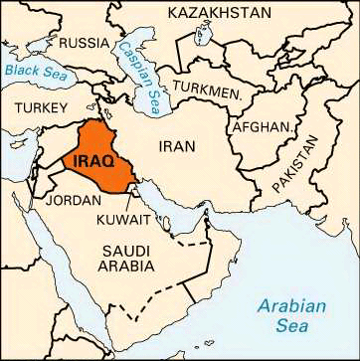
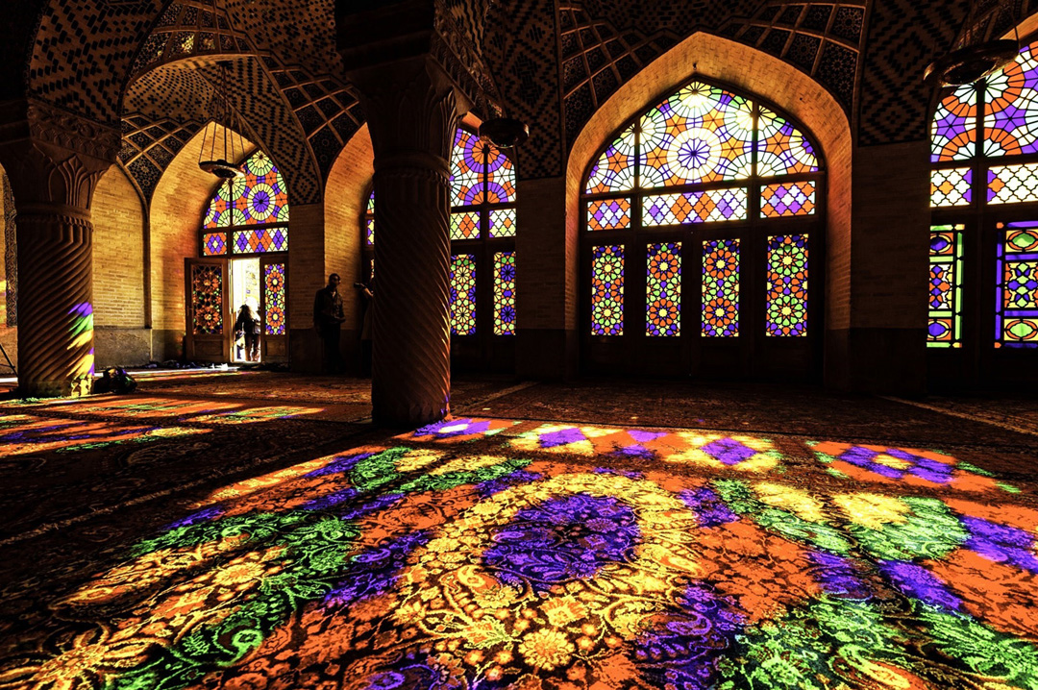
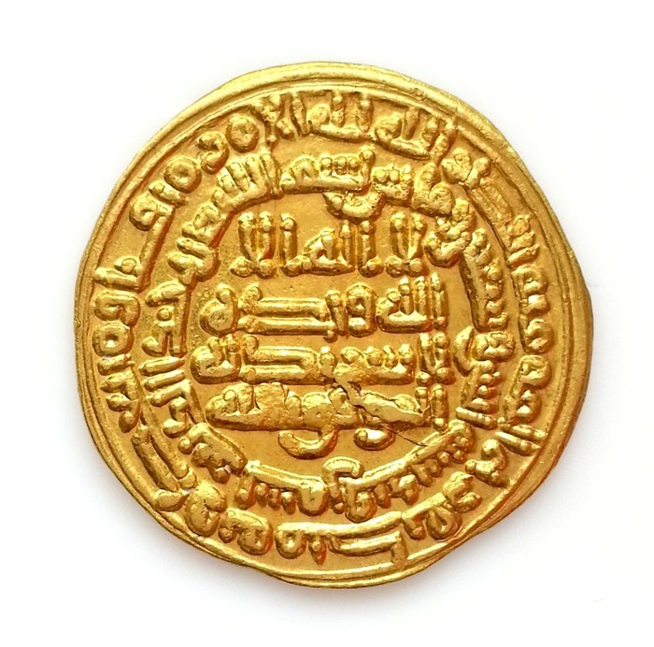

Slide 29
Nasir al-Din al-Tusi

Slide 30
House of Wisdom

Slide 31
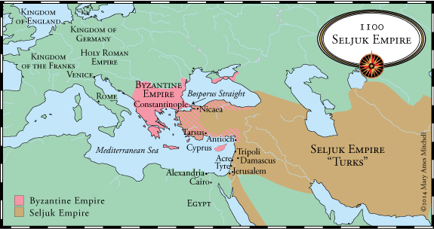
Turkish Peoples (Turks)

Slide 32
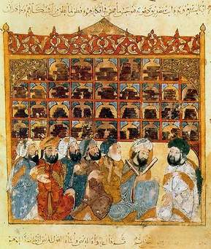
Ulama
Yet drawing and redrawing political boundaries did not result in the rigid divisions of the Islamic world into kingdoms. Religious and cultural developments, particularly the rise in cities of a social group of religious scholars known as the ulama, worked against any permanent division of Islamic ummah.

Slide 33
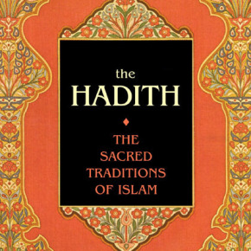
Shari’a and Hadith
Shari’a: the law of Islam
Islam slowly developed laws to govern social and religious life (Islam had no legal system in the time of Muhammad, just follow his example but became too hard for non-Arab converts who little familiarity with the religion)
Hadith: refers to reports of statements or actions of Muhammad, or of his tacit approval or criticism of something said or done in his presence. Unlike the Qur'an, not all Muslim believe Hadith accounts (or at least not all Hadith accounts) are divine revelation. (some controversial)
As it gradually evolved, the Shari’a embodied a vision on an ummah in which all subscribed to the same moral values. Every Muslim ruler was expected to abide by and enforce religious law.

Slide 34
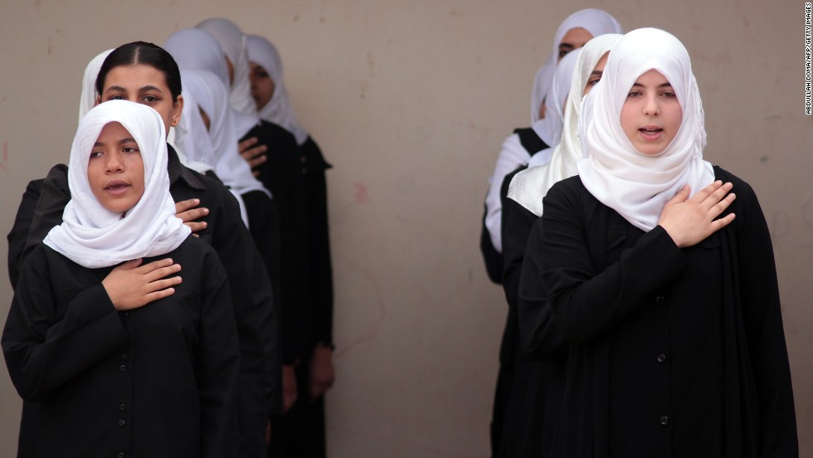
Women in Islam

Slide 35
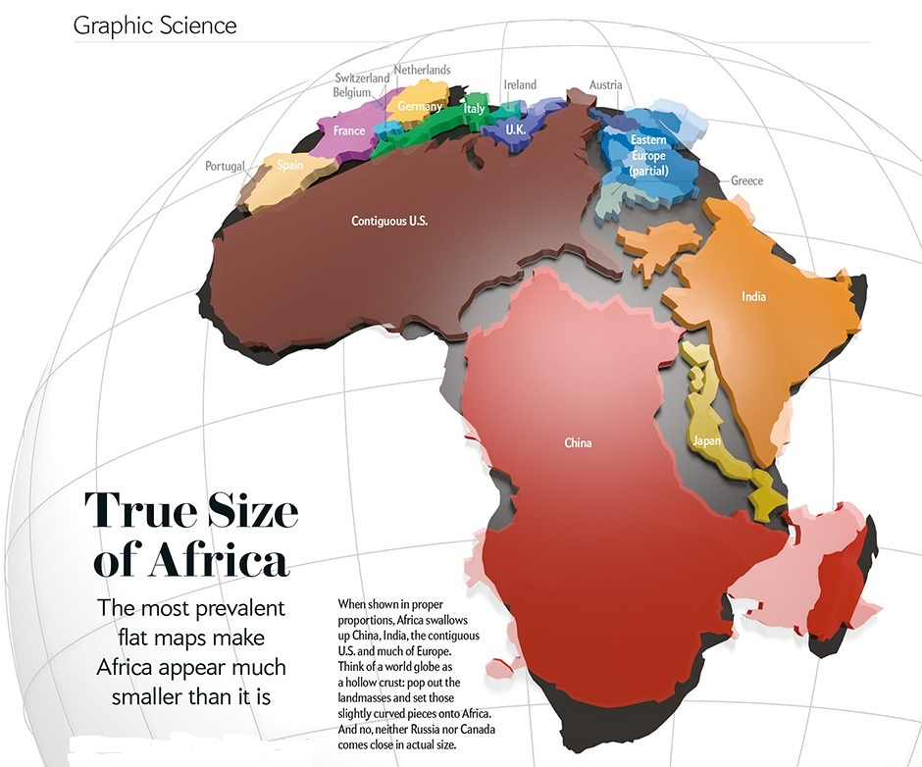
Africa and Islam
Oral rather than written tradition (problem for history?)

Slide 36
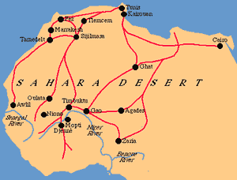
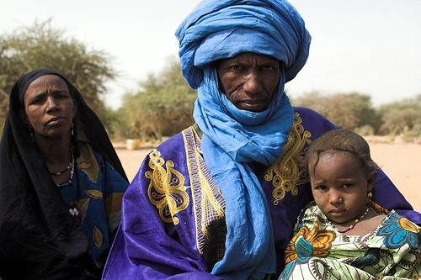
Berbers (Tuareg peoples part of)
Berbers are an ethnic group indigenous to North Africa, primarily inhabiting Algeria, northern Mali, Mauritania, Morocco, northern Niger, Tunisia, Libya and a part of western Egypt.
Berbers exchanged salt for gold with West Africa= early converts to Islam (commercial connection)
Converting to Islam equaled prestige and access

Slide 37
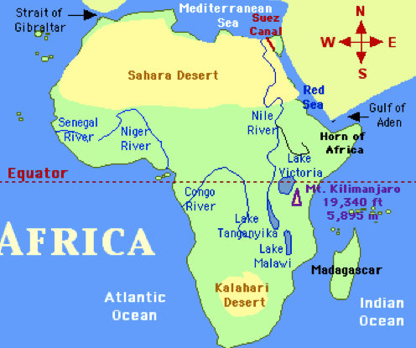
Trans-Saharan Trade
Trans-Saharan trade requires travel across the Sahara(north and south) to reach sub-Saharan Africa from the North African coast, Europe, to the Levant.

Slide 38
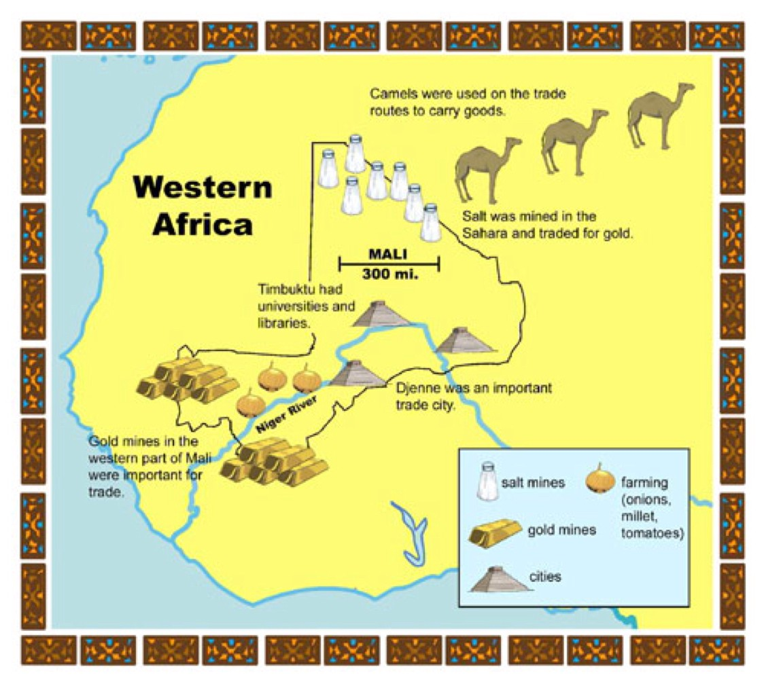
Women in Islam
Oral rather than written tradition (problem for history?)

Slide 39
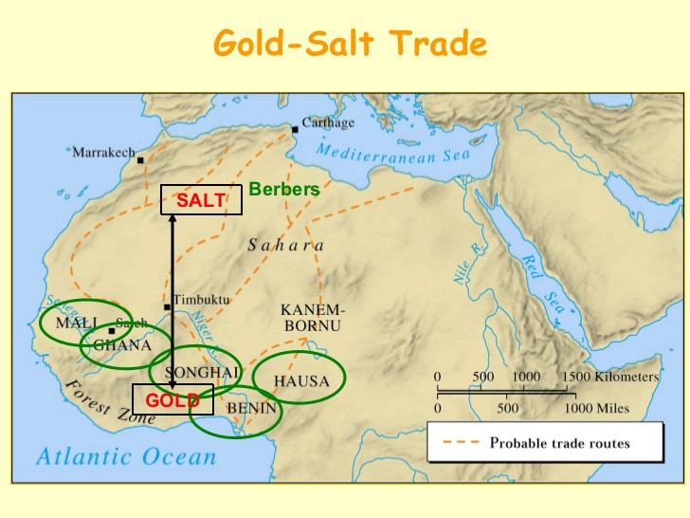
Women in Islam
Oral rather than written tradition (problem for history?)

Slide 41
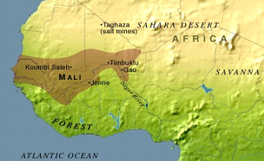
Ghana Empire → Mali Empire
Ghana Empire (11th century) Islamic traditions formed
Mali Empire (increase knowledge and practice of Islam
1337 CE Timbuktu (largest Mali city)

Slide 42
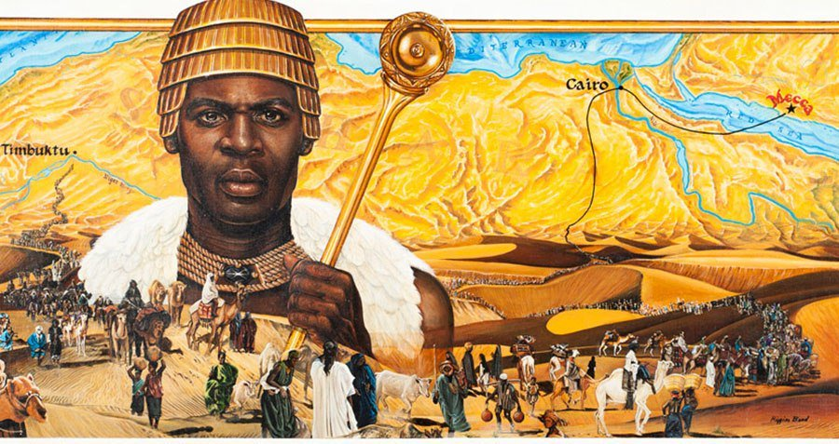
Mansa Musa
West Africa land of gold?
What we know: He was Muslim, devote, and relatively connected
Brought back scholars and built a bunch of Mosques

Slide 43
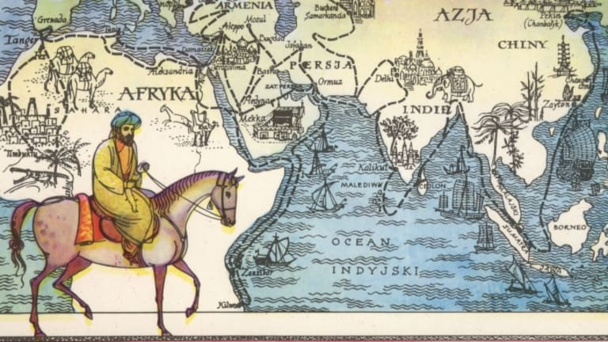
Ibn Battuta
Knowledge of Islam on the greatest road trip ever
(February 25, 1304 – 1368 or 1369) was a Berber Muslim
Explorer who widely travelled the medieval world over a period of 30 years (visited most of Islamic world and many non-Muslim lands)
He dictated an account of his journeys, titled A Gift to Those Who Contemplate the Wonders of Cities and the Marvels of Travelling. This account of his journeys provides a picture of medieval civilizations that is still widely consulted today.

Slide 44
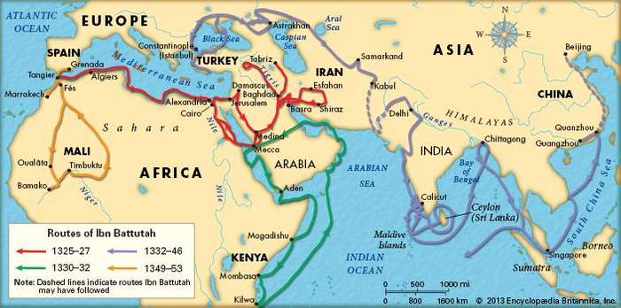
Ibn Battuta
Knowledge of Islam on the greatest road trip ever
(February 25, 1304 – 1368 or 1369) was a Berber Muslim
Explorer who widely travelled the medieval world over a period of 30 years (visited most of Islamic world and many non-Muslim lands)
He dictated an account of his journeys, titled A Gift to Those Who Contemplate the Wonders of Cities and the Marvels of Travelling. This account of his journeys provides a picture of medieval civilizations that is still widely consulted today.

Slide 45
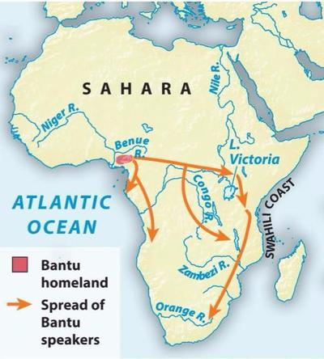
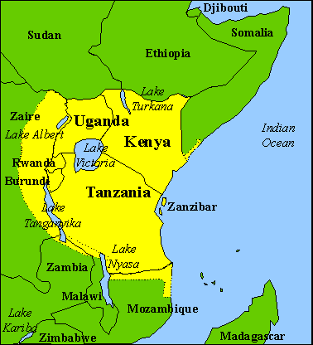
Swahili Civilization
City-states, no central government, all autonomous but linked through trade routes
Bantu linked: language, trade and culture
Islamic religious and commercial connections (Indian Ocean Trade)
13-16th Century large mosques and highly advanced trade

Slide 46
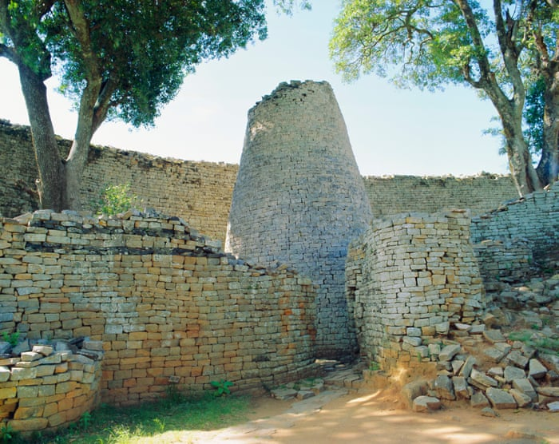
Great Zimbabwe

Slide 47
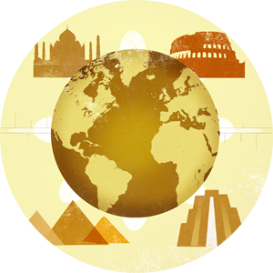
Africa in history
Africa shows us we need to look at all sources (not just written ones)
Africa is a diverse rich place not separated from but apart of our history

