Slide 1
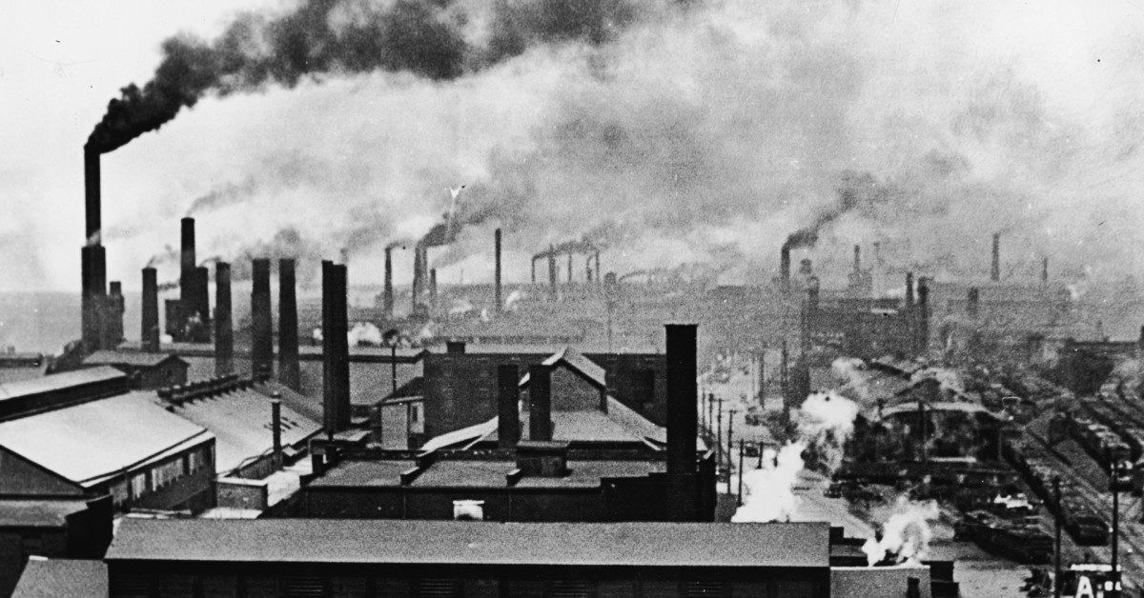
The Industrial Revolution

Slide 2
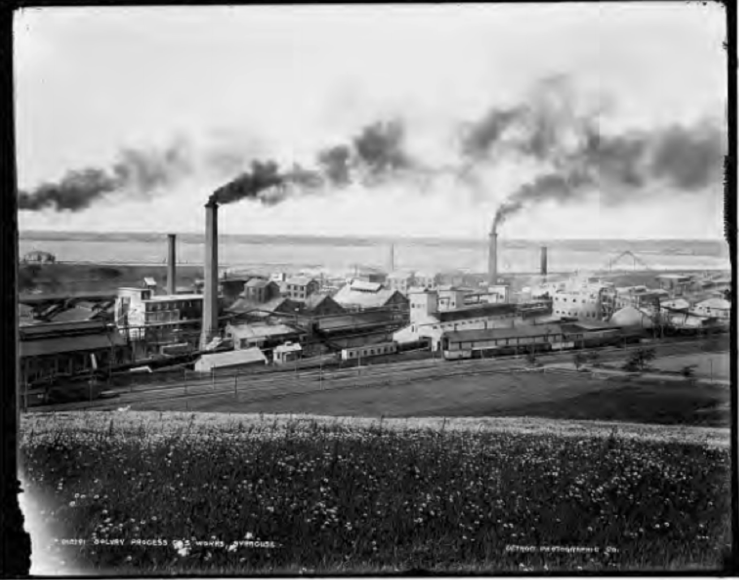
Industrial Revolution Begins
When: 1760- 1820ish, then late 19th century again
Where: Started in Great Britain
What: Agarin to mechanization/ mass-manufacturing

Slide 4
Pre-Industrial Societies
Cottage industry
The putting-out system is a means of subcontracting work. Work was completed in off-site facilities, either in their own homes or in workshops with multiple craftsmen (skilled labor).
This was suited to pre-urban times because workers did not have to travel from home to work, which was quite unfeasible due to the state of roads and footpaths, and members of the household spent many hours in farm or household tasks. Early factory owners sometimes had to build dormitories to house workers, especially girls and women.
Putting-out workers had some flexibility to balance farm and household chores with the putting-out work, this being especially important in winter.

Slide 5
Britain's Industrial Advantages?

Slide 6
Industrial Revolution Causes
A.) Agricultural Improvements= Population Growth
1. Agricultural Revolution in early 1700s
*Crop Rotation
*Seed Drill
*The Potato
Result: With these demographic changes, more people were available to work in factories and provide a market for manufactured goods.

Slide 7
Industrial Revolution Causes
B.) Geography
1. Proximity to waterways= Access to rivers and canals
2. Mineral resources of coal, iron, and timber
Results: The fossil fuels revolution greatly increased the energy available to human societies (also deforestation)

Slide 9
Industrial Revolution Causes
C.) Growth of New Technologies
1. Spinning Jenny (textile manufacturing)
2. Interchangeable Parts (Eli Whitney)
3. Water frame (Richard Arkwright)
4. Steam Engines (James Watt improved)
Results:
Assembly Line= specialization of labor replaced by division of labor=
Factory System= mass production

Slide 10
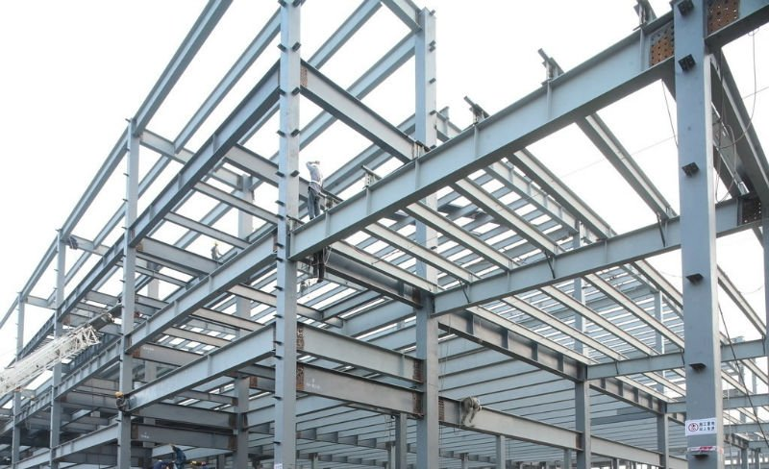
Industrial Revolution Causes
D.) “Second Industrial Revolutions”
1. The “second industrial revolution” led to new methods in the production of steel, chemicals, electricity, and precision machinery during the second half of the 19th century.

Slide 11
Industrial Revolution Causes
E.) Resources from Colonies
1. Access to raw materials from colonies to manufacture and sell to
2. British capitalists/ entrepreneurs had extra capital to invest $$$
3. Strong naval fleets= defense of commercial trading ships

Slide 12
Industrial Revolution Causes
F.) Urbanization
1. British Enclosure Movement
*Larger more complex farms
* Legal protection of private property
*Poor farmers move to cities for work= available labor force
The Enclosure Movement was a push in the 18th and 19th centuries to take land that had formerly been owned in common by all members of a village, or at least available to the public for grazing animals and growing food, and change it to privately owned land, usually with walls, fences or hedges around it

Slide 14
Economic and Political Developments
A.) Economic Boom
1. Factories= More efficient manufacturing and mass-production possible= HUGE economic growth
2. Factory assembly line= shift to unskilled labor = more jobs available
3. Railroads, steamships, and the telegraph made exploration, development, and communication possible in interior regions globally, which led to increased trade and migration

Slide 16
Econ/ Pol Developments
B.) Laissez Faire Capitalism/ Entrepreneurship
1. Scottish economist Adam Smith “Wealth of Nations” (1776)
2. Gov. hand’s off economy, instead determined by supply and demand= free market
3. Smith argued that if individuals were allowed to seek personal gain, the effect, as though guided by an “invisible hand,” would be to increase the general welfare. The government should refrain from interfering in business, except to protect private property.
4. Mercantilism fades: persuaded by Adam Smith’s arguments, governments dismantled many of their regulations in the decades after 1815

Slide 18
Economic and Political Developments
C. Europe and America
“Acutely aware of Britain’s head start and the need to stimulate their own industries, European governments took action. They created technical schools. They eliminated internal tariff barriers, tolls, and other hindrances to trade. They encouraged the formation of joint-stock companies and banks to channel private savings into industrial investments. On the European continent, as in Britain, cotton cloth was the first industry. The mills of France, Belgium, and the German states served local markets but could not compete abroad with the more advanced British industry. By 1830 the political climate in western Europe was as favorable to business as Britain’s had been a half-century earlier.”

Slide 21
Economic and Political Developments
D.) Josiah Wedgwood (18th century)

Slide 22
Society in the Industrial Age
A.) New Social Classes
1. Industrialization led to new elites (rise of bourgeoisie). Capitalism led to the formation of a comfortable middle class in industrial societies.
2. Aristocrats maintained power through existing wealth. Many traditional elites remained powerful in the 18th and 19th centuries because they used their wealth to engage or invest in industrial capitalism.
3. Exploited working class ☹

Slide 23
Society in the Industrial Age
B.) Population and City Growth
1. Sudden population growth, overcrowding, and inadequate municipal services conspired to make urban problems more serious than in earlier times
2. Air pollution from burning coal, natural resources heavily mined/depleted
3.Increased immigration = urbanization/ crowded cities/ filthy environment/ slum tenements = disease spreads
“Industrialization made some people very prosperous. A great deal of this new wealth went into the building of fine homes, churches, museums, and theaters in wealthy neighborhoods in London, Berlin, and New York. Much of the beauty of London dates from the time of the Industrial Revolution. Yet, by all accounts, the industrial cities grew much too fast, and much of the growth occurred in the poorest neighborhoods.”

Slide 24
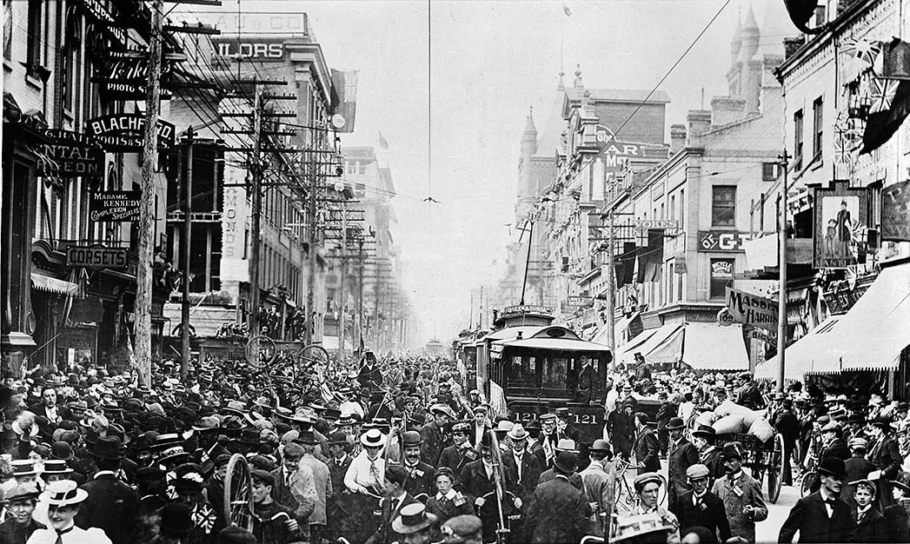

Slide 25
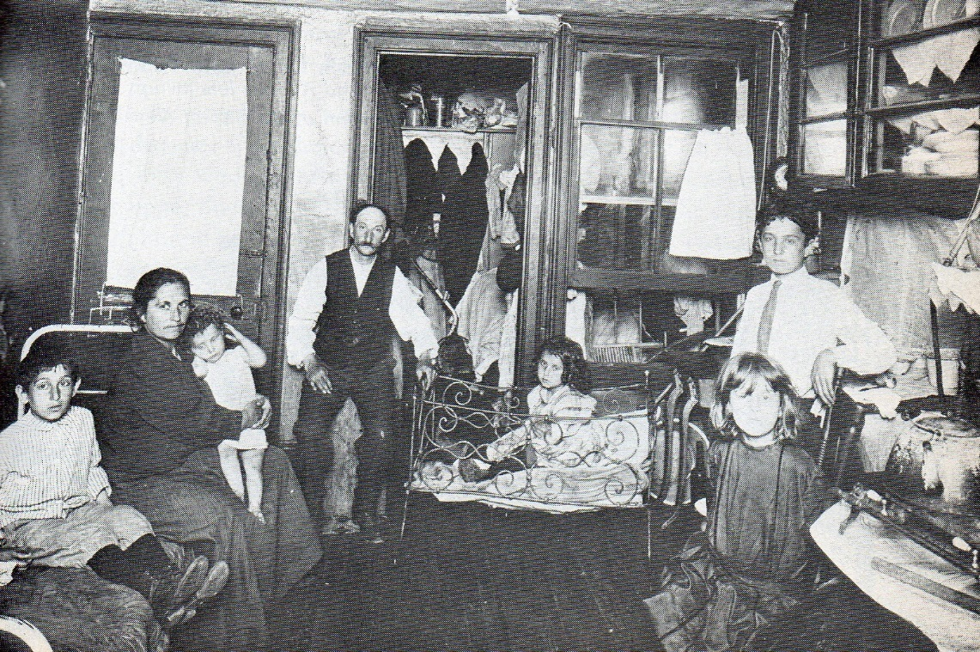
Tenement Housing in New York City

Slide 26
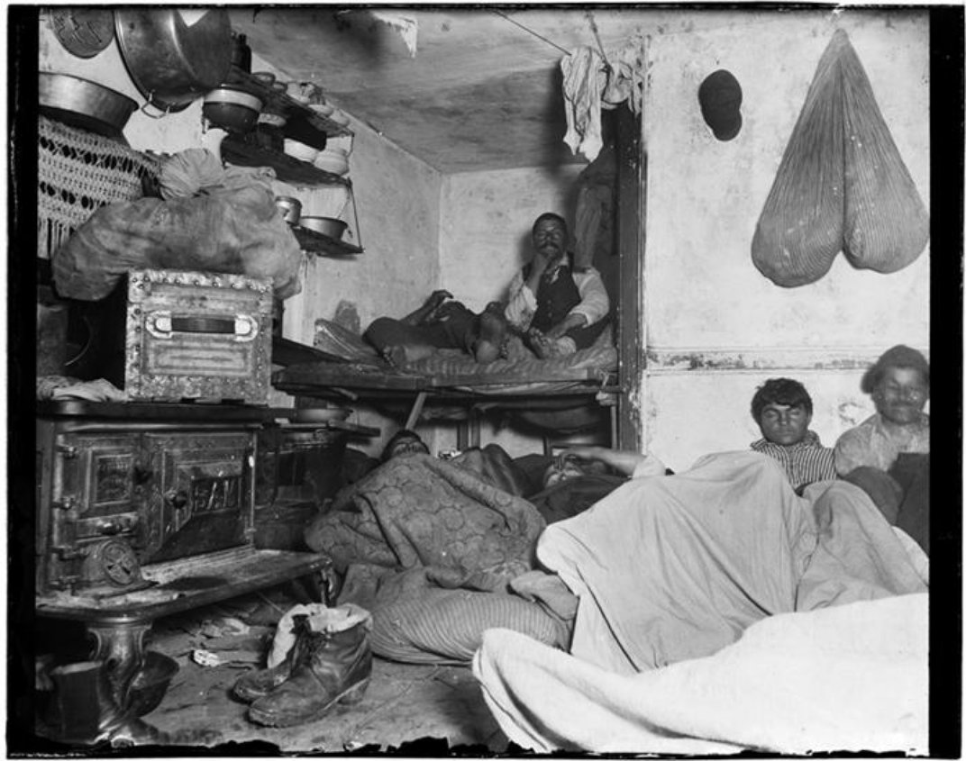

Slide 27
John Snow (Cholera Outbreak London 1854)

Slide 28
Thomas Malthus (population and sustainability)

Slide 29
Society in the Industrial Age
C.) Working Conditions
1. Most industrial jobs were unskilled, repetitive, boring, and DANGEROUS.
2. Lightbulb in late 1800s expanded working hours.
3. Workdays were long; there were few breaks; and foremen watched constantly. Industrial accidents were common and could ruin a family.

Slide 30
Society in the Industrial Age
D.) Child Labor
“Even with both parents working, poor families found it hard to make ends meet. As in preindustrial societies, parents thought children should contribute to their upkeep as soon as they were able to. The first generation of workers brought children as young as five or six with them to the factories and mines; they had little choice, since there were no public schools or daycare centers. Employers encouraged the practice and even hired orphans. They preferred children because they were cheaper and more docile than adults and were better able to tie broken threads or crawl under machines to sweep the dust.
In Arkwright’s cotton mills two-thirds of the workers were children. In another mill 17 percent were under ten years of age, and 53 percent were between ten and seventeen; they worked fourteen to sixteen hours a day and were beaten if they made mistakes or fell asleep. Mine operators used children to pull coal carts along the low passageways from the coal face to the mine shaft. In the mid-nineteenth century, when the British government began restricting child labor, mill owners increasingly recruited adult immigrants from Ireland.”

Slide 32
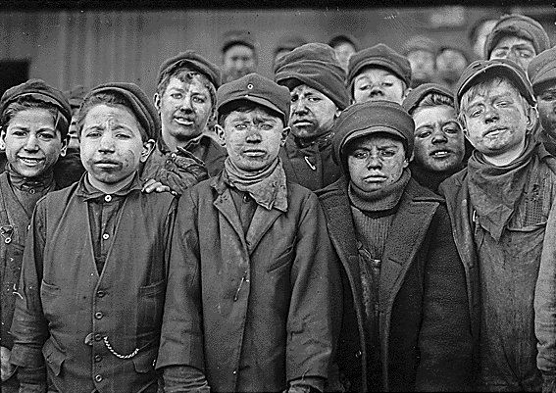

Slide 33
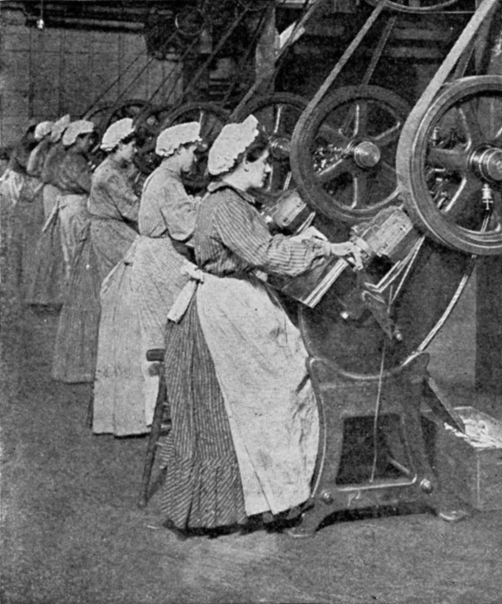
Society in the Industrial Age
E.) Gender Roles
1. Gender roles changed= new work and professional opportunities
2. Working class women worked in textile mills vs separate spheres ideas (cult of domesticity)
3. On average, women earned one-third to one-half as much as men.
4. Feminism emerged to advocate for allowing women to gain access to the new jobs, educational opportunities, and expanding political rights available to men in industrial societies.

Slide 35
Society in the Industrial Age
F.) Social Darwinism
1. “natural selection” and “survival of the fittest” within society= used to justify political conservatism, imperialism, and racism and to discourage intervention and reform
2. Nationalism, Nativism, and Social Darwinism emerged to promote military and imperial expansion favored by the new industrial elites.

Slide 36
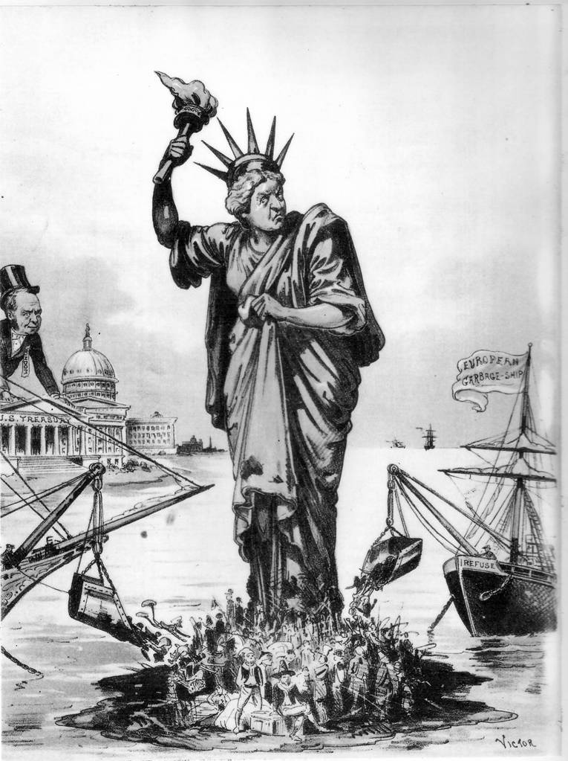
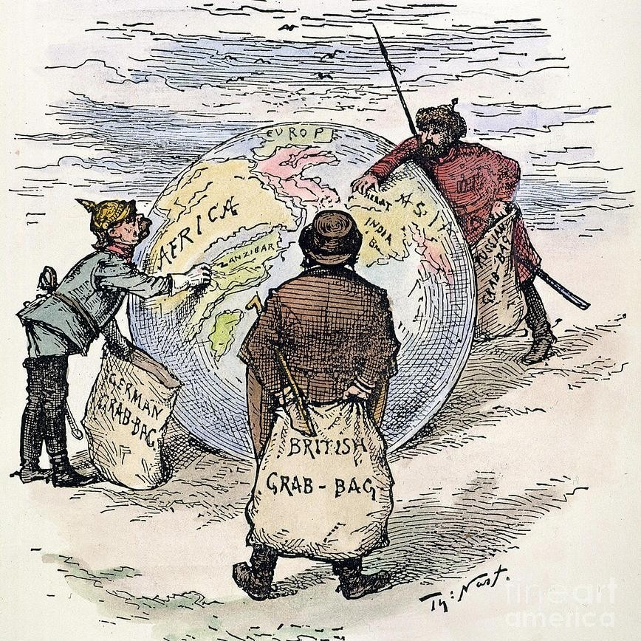

Slide 38
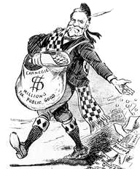
Philanthropy (“Gospel of Wealth”)

Slide 39
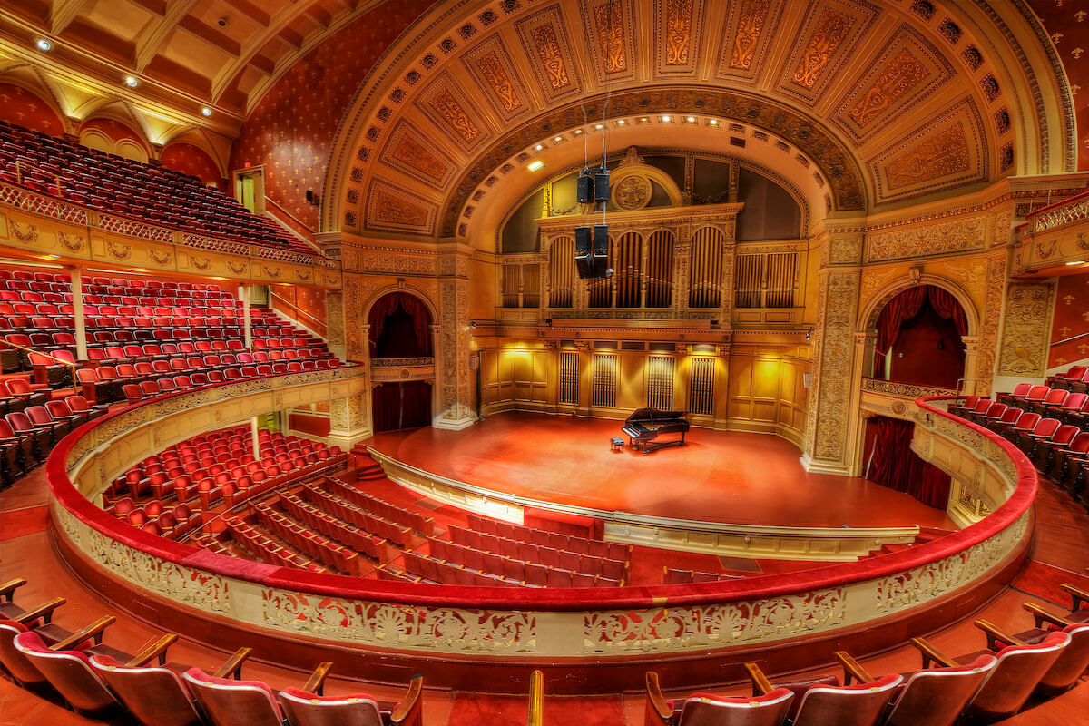
Carnegie Hall (NYC)

Slide 40
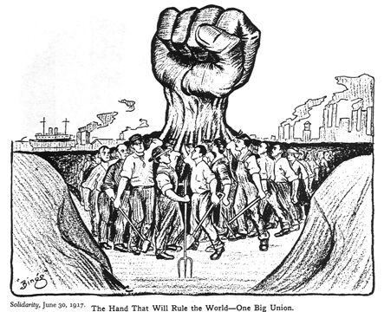
Reactions to Industrialization
A.) Protests and Reforms
1. Workers had no political power and began forming labor unions demanding reforms= labor strikes
2. Eventually, mass movements persuaded political leaders to look into the abuses of industrial life, despite the prevailing laissez-faire philosophy. In the 1820s and 1830s the British Parliament began investigating conditions in factories and mines. The Factory Act of 1833 prohibited the employment of children younger than nine in textile mills.

Slide 42
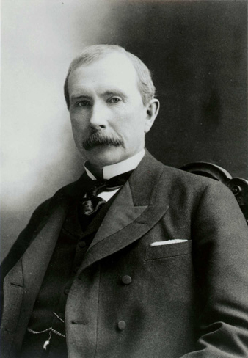
John D. Rockefeller (Standard Oil Company 1870= Monopoly/Trust)

Slide 43
Reactions to Industrialization
B.) Socialism
1. Socialism emerged as a reaction against the perceived excesses of the capitalist industrial class.
2. Socialism (social ownership of the means of production)
3. Utopian socialism= achieved by the moral persuasion of capitalists to surrender the means of production peacefully to the people.
4. One key difference between utopian socialists and other socialists such as most anarchists and Marxists is that utopian socialists generally do not believe any form of class struggle or social revolution is necessary for socialism to emerge.

Slide 44
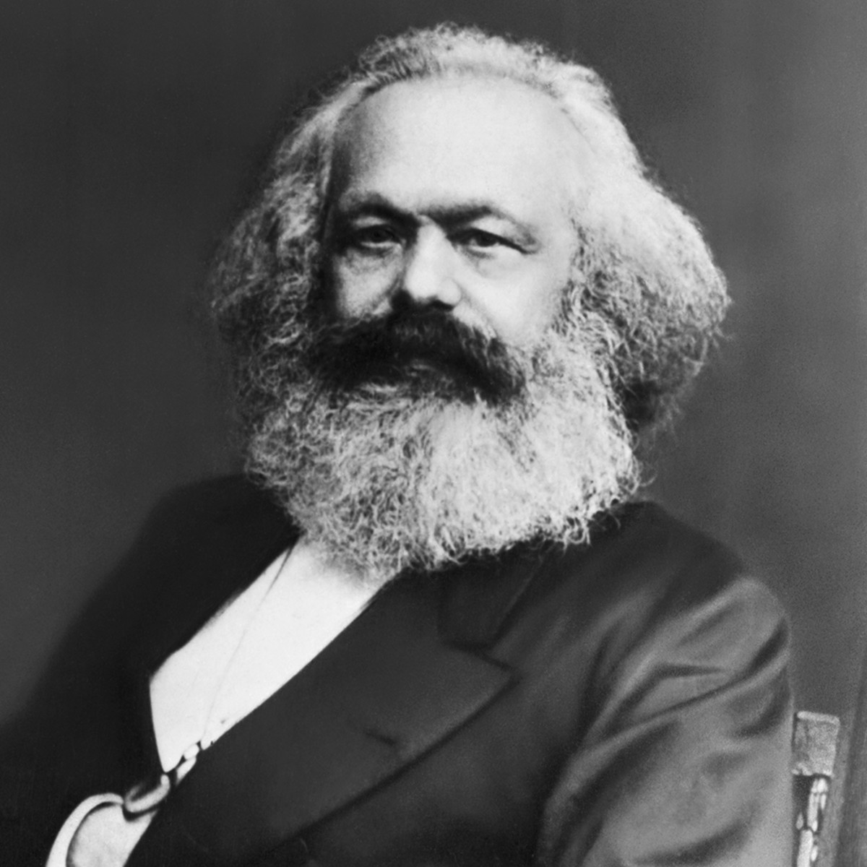
Karl Marx and Friedrich Engels “The Communist Manifesto” (1848)
Advocated a class war (proletariats vs bourgeoisie) and wanted a society in which all property is publicly owned and everyone is paid accordioning to their needs

Slide 45
Industrialization and the Non-Industrialized World
A.) Western Powers Continued Exploitation
“While the cotton boom enriched planters, merchants, and manufacturers, African-Americans paid for it with their freedom. In the 1790s, 700,000 slaves of African descent lived in the United States. The rising demand for cotton and the British and American prohibition of the African slave trade in 1808 caused an increase in the price of slaves. As the “Cotton Kingdom” expanded, the number of slaves rose through natural increase and the reluctance of slave owners to free their slaves. By 1850 there were 3.2 million slaves in the United States, 60 percent of whom grew cotton. Similarly, Europe’s and North America’s surging demand for tea and coffee prolonged slavery in the sugar plantations of the West Indies and caused it to spread to the coffee-growing regions of southern Brazil. In the British West Indies slavery was abolished in 1833, but elsewhere in the Americas it persisted for another thirty to fifty years. Slavery was not, as white American southerners maintained, a “peculiar institution”—a consequence of biological differences, biblical injunctions, or African traditions. Slavery was just as much part and parcel of the Industrial Revolution as child labor in Britain, the clothes that people wore, and the beverages they drank.”

Slide 46
Industrialization and the Non-Industrialized World
B. Middle East and Asia
1. While Middle Eastern and Asian countries continued to produce manufactured goods, these regions’ share in global manufacturing declined.
2. The expansion of U.S. and European influence in Asia led to internal reform in Japan that supported industrialization and led to the growing regional power of Japan in the Meiji Era.

Slide 47
Industrialization and the Non-Industrialized World
C. Japan- Meiji Era
1. In 1853 the American Commodore Matthew C. Perry arrived off the coast of Japan with a fleet of steam powered warships. He demanded that Japan open its ports to trade and allow American ships to refuel and take on supplies= Japan forced to sign Treaty of Kanagawa
2. Japanese elites overthrow Tokugawa shogunate and took the position that they needed to modernize the state's military capacities, or risk further coercion from Western powers

Slide 49
Industrialization and the Non-Industrialized World
D. Ottoman Empire= nationalist movements
1. In response to the expansion of industrializing states, some governments in Asia and Africa, including the Ottoman Empire and Qing China, sought to reform and modernize their economies and militaries. Reform efforts were often resisted by some members of government or established elite groups.
2. “Sick Man of Europe”
3. Muhammad Ali (Modern Egypt)
4. Tanzimat Reforms (1839-76)

Slide 50
Industrialization and the Non-Industrialized World
E. Qing China
1. Self-Strengthening Movement
2. Hundred Days Reform (Empress Cixi and conservative ruling elite coup d’etat)
3. China made substantial progress toward modernizing its heavy industry and military but the majority of the ruling elite still subscribed to a conservative Confucian worldview, and the "self-strengtheners" were by and large uninterested in social reform beyond the scope of economic and military modernization.

