Slide 1
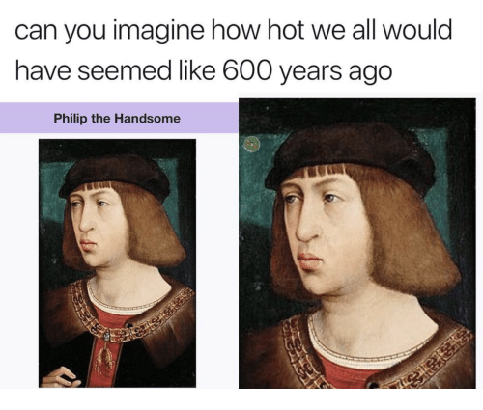
Europe in the Middle Ages
WORLD HISTORY

Slide 2
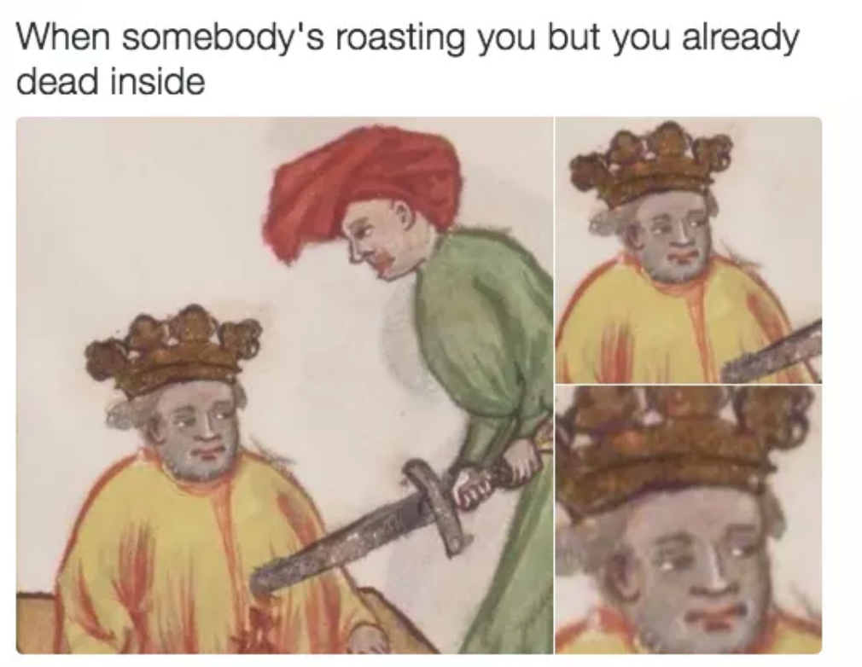
“The Dark Ages”

Slide 3
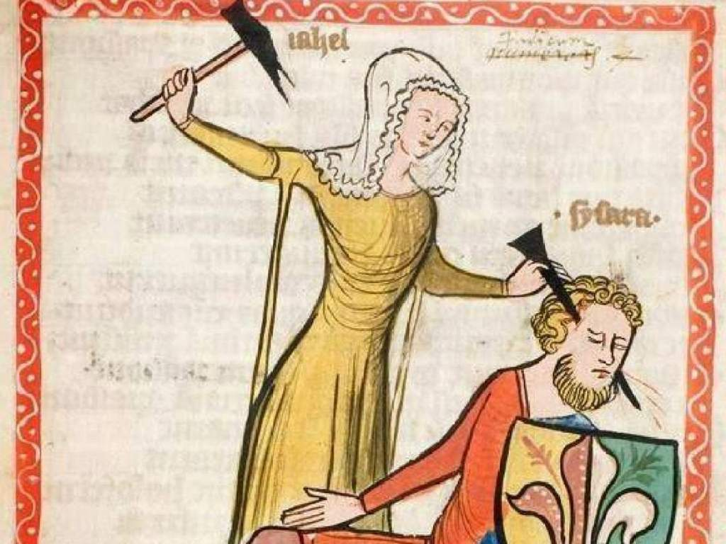
Why so Dark?

Slide 4
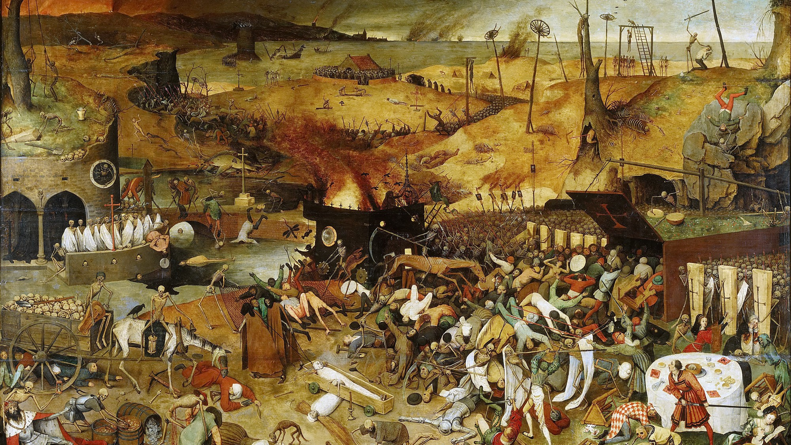

Slide 5
“The Dark Ages”/ Middle Ages (600-1450)
Western Europe, after the fall of the Roman Empire in the West in 476, had:
  Power void
  Less trade
  Fewer cities
  Less cultural output
  Smelly, super smelly
  Superstitious
  Life expectancy was 30

Slide 6
Elsewhere in the world…
Byzantine Empire (395–1453)
Golden Age of Islam (Abbasid Caliphate, 750-1258 and Baghdad)
Chinese Dynasties (Tang Dynasty, 618-907, and Song Dynasty, 960- 1279)
Delhi Sultanate (1206–1526)
Khmer Empire (802- 1431)
Heian Japan (794 to 1185) → Shogunates
Mongol Empire (13th and early 14th centuries) → Yuan Dynasty, Golden Horde, Il-Khanate
Pre-Columbian Societies in the Americas

Slide 7
Middle Ages Periodization
Early Middle Ages (500- 1000)
High Middle Ages (1000- 1250)
Late Middle Ages (1250- 1500)

Slide 8
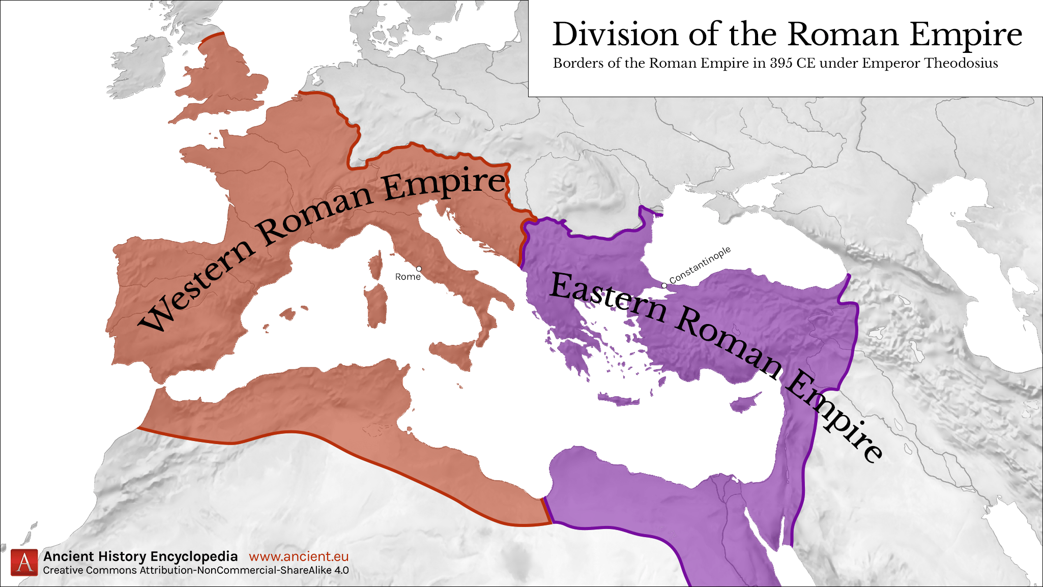
East vs. West Roman Empire

Slide 9
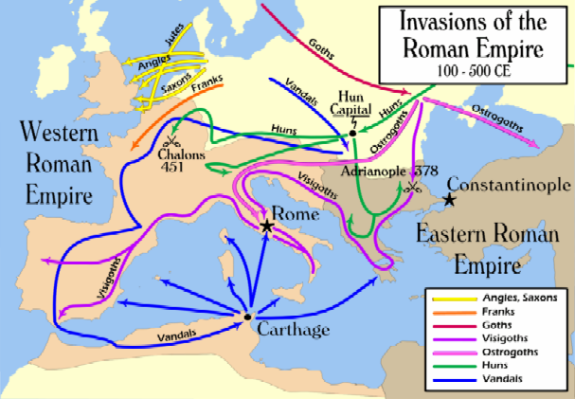
Fall of the Western Roman Empire (476)

Slide 10
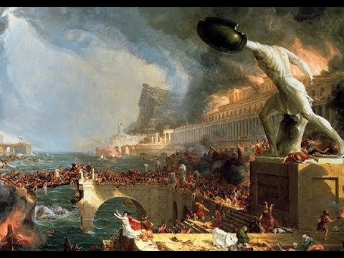
Medieval Europe
Period between Fall of Western Rome (476) to European Renaissance in the 14th century (1300s).
During the High Middle Ages, which began after 1000, the population of Europe increased greatly as technological and agricultural innovations allowed trade to flourish and the Medieval Warm Period climate change allowed crop yields to increase.

Slide 11
Quest for Political and Social Order
Feudalism
Serfs and manors
The medieval Christian Church

Slide 12
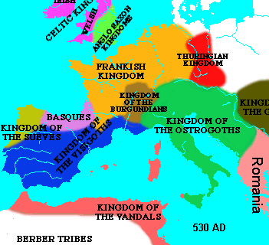
Low Middle Ages- Mostly Decentralized
Decentralized Society/ Kingdoms
  German chieftains replace Roman rule
  Germanic tradition replaced Roman law
  Peasants turn to local lords for safety
Subsistence Agriculture
Power shifts from Italy to France

Slide 13
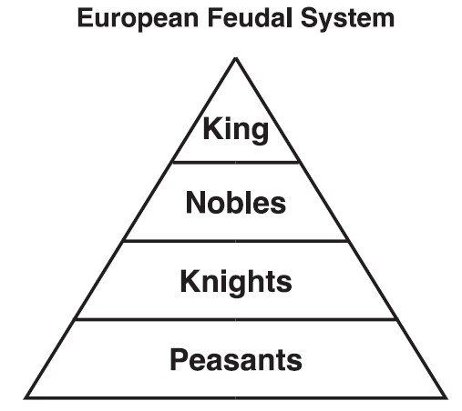
European Feudalism
Kings and nobles gave land (fief ) to vassals (nobles) in exchange for military service
  Control of land was hereditary
Vassals gave land to knights in exchange for military service
  Knights were bound by a code of chivalry

Slide 14
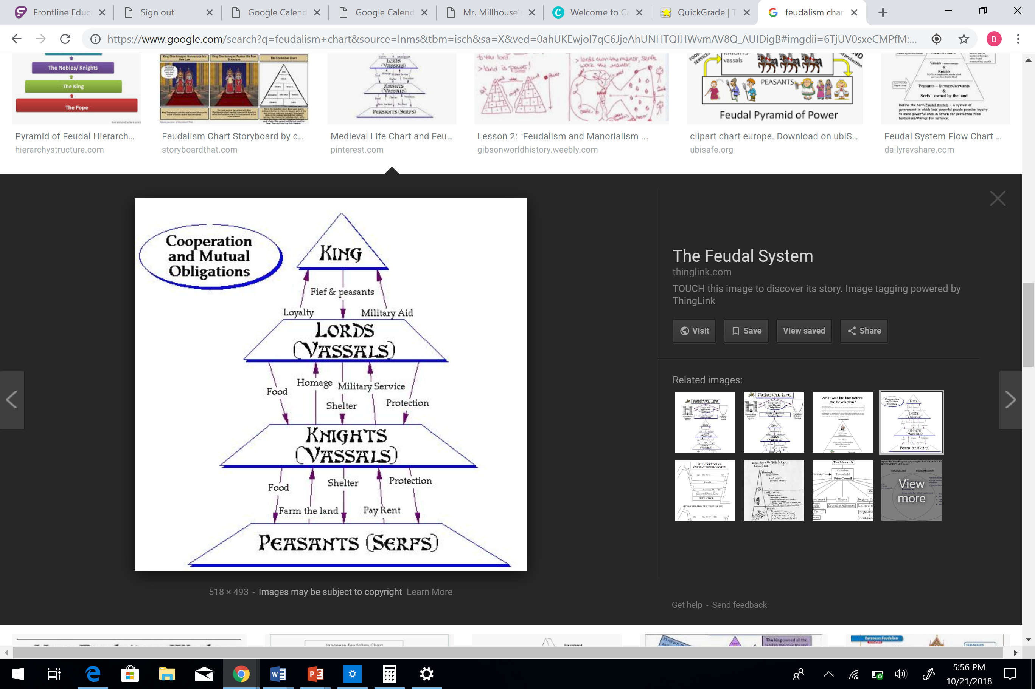
European Feudalism

Slide 15
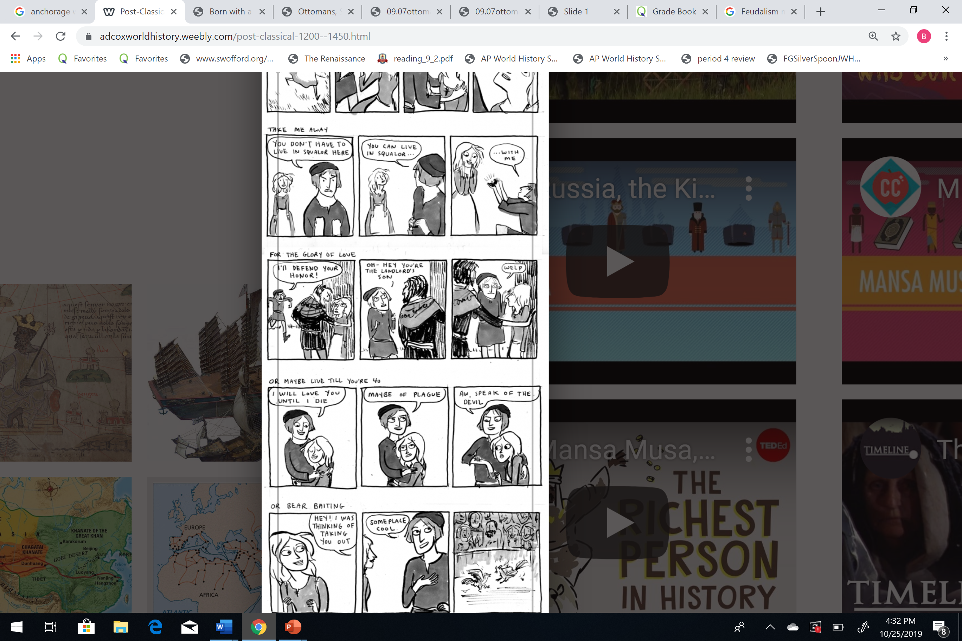
Feudalism

Slide 16
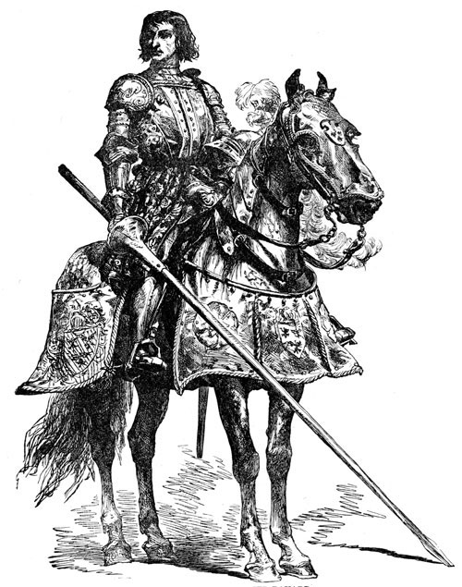
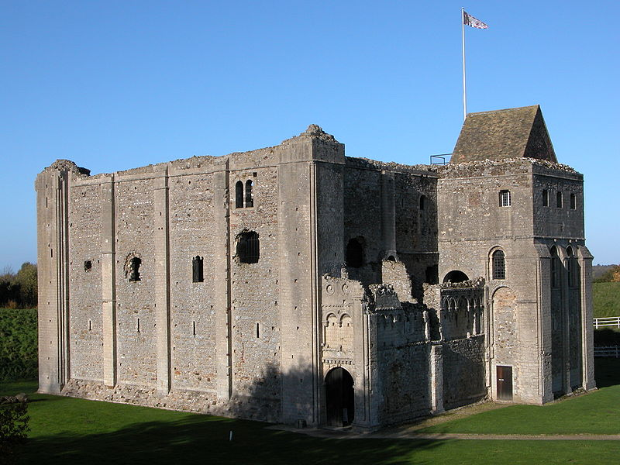
Knights and Castles
The Knight
The Castle
Castle Rising in England was built in 1138

Slide 17
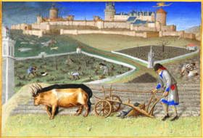
Serfs and Manorialism
Agricultural manors were essential for maintaining the feudal system
  Manors included a mill, church, workshops, and a village
Serfdom
  Bound to the land
  Cultivated land for lords in exchange for protection and a small plot of land
  Also were responsible for weaving, building, etc.
Serfs were required to work their lords land three days a week. The rest of the time they could work the small plots of land provided to them by their lord.

Slide 18
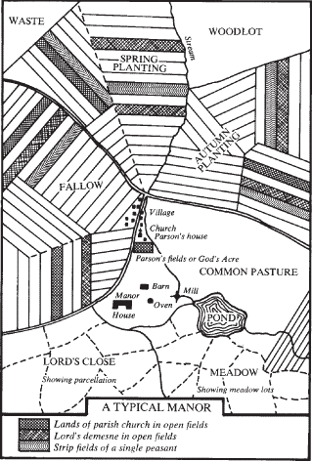
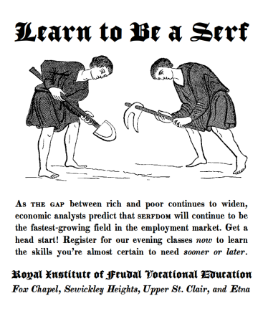
Manorialism

Slide 19
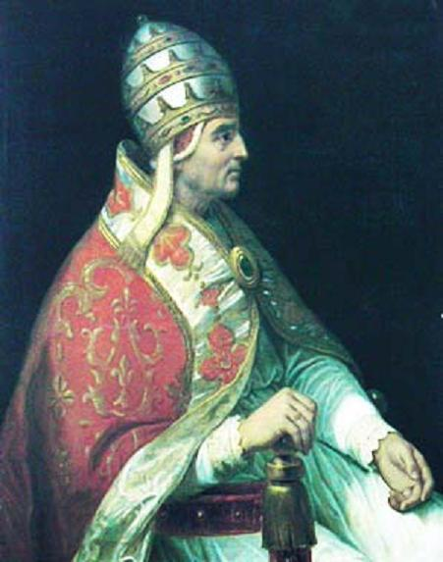
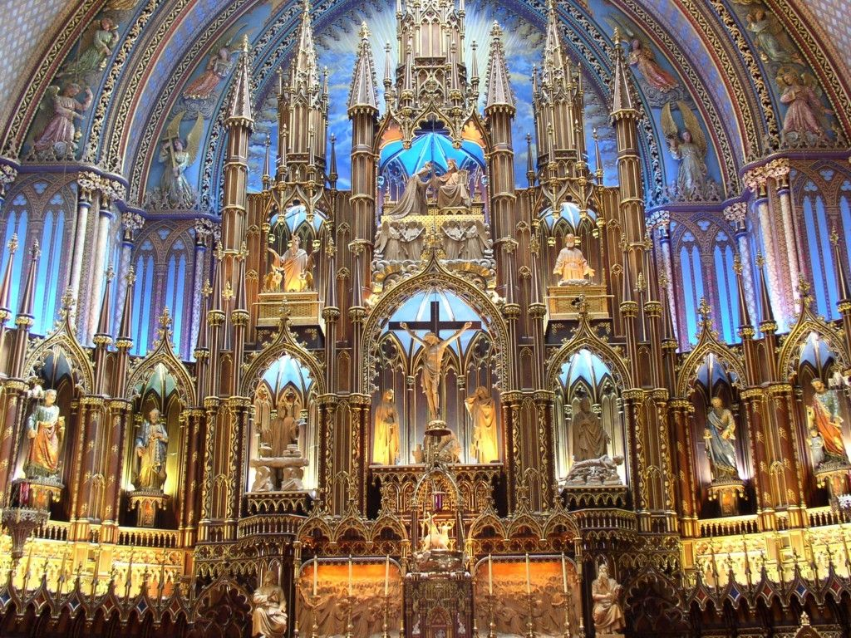
Rise of the Catholic Church and Papal Authority in the West (ROME)

Slide 20
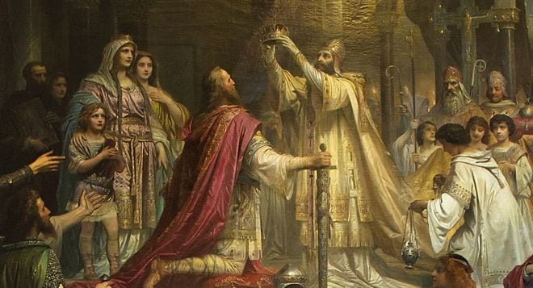
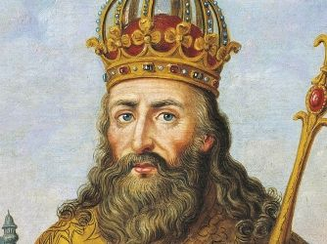
Charlemagne
King of Franks, crowned Holy Roman Emperor by the Pope in 800.
During the Early Middle Ages, he united the majority of western and central Europe. He was the first recognized emperor to rule from western Europe since the fall of the Western Roman Empire three centuries earlier.

Slide 21
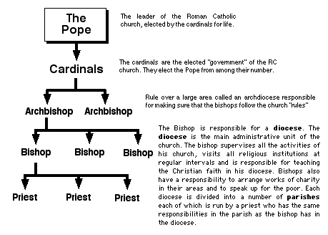
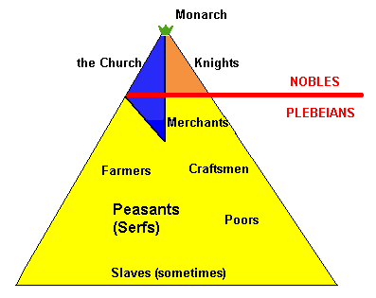
The Christian Church
Created moral standards
Owned extensive land throughout Western Europe
Struggled with secular rulers to be the dominant authority in Europe
Supported monasticism
  Monks preserved literacy and learning
  Nuns provided an additional opportunity for women

Slide 22
The Great Schism - 1054
Orthodox Christianity
Roman Catholic Christianity
Eastern Europe
Constantinople
Greek
Iconoclasm
Priests could marry
Easter
Caesaropapism
Western Europe
Rome
Latin
Support use of icons
Priests remain celibate
Christmas
Pope
They also disagree on:
The nature of the Trinity
Relative importance of faith and reason

Slide 23
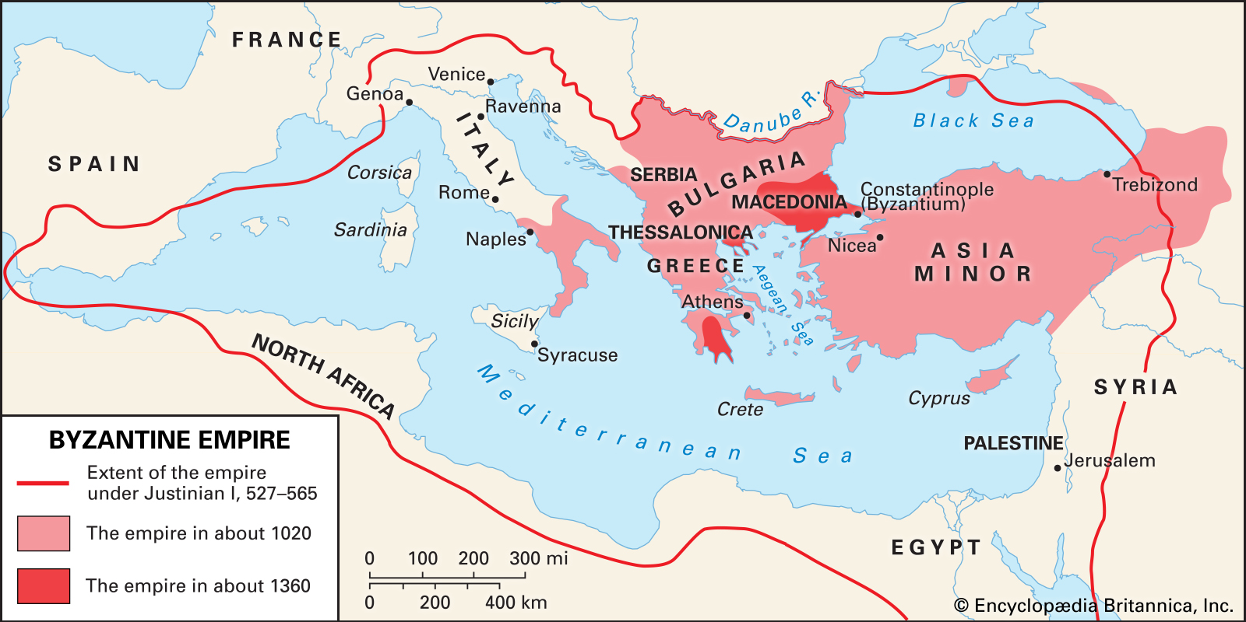
Byzantine Empire (Eastern Roman Empire)

Slide 24
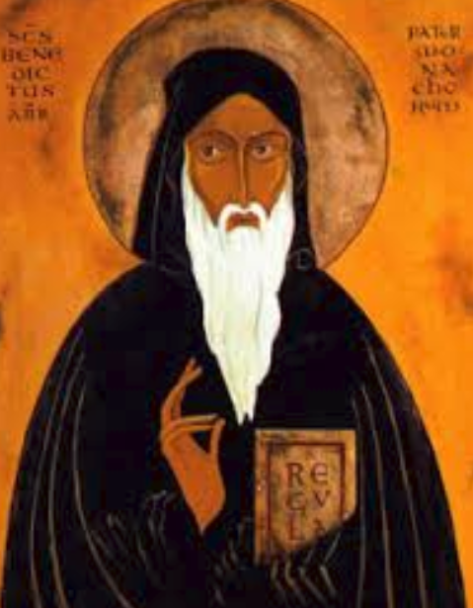
The Rule of Benedict (Monasticism)
Benedict of Nursia (480- 547)
Organized monasteries head by an abbot
Abbot, meaning father, is an ecclesiastical title given to the male head of a monastery
Govern the monks’ behavior (balanced life of devotion, work, celibacy, poverty, and obedience to the abbot)
Formal code of regulations
Benedict of Nursia began his pious career as a hermit in a cave

Slide 25
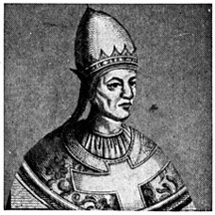
The Pope
Papal authority grew during early medieval period
  Canon law (law of the church)
  Excommunication
  Investiture/Ecclesiastical Appointments
Frequent power struggles between monarchs and the papacy
A symbol of papal authority, Pope Gregory VII declared the church infallible and capable of removing emperors

Slide 26
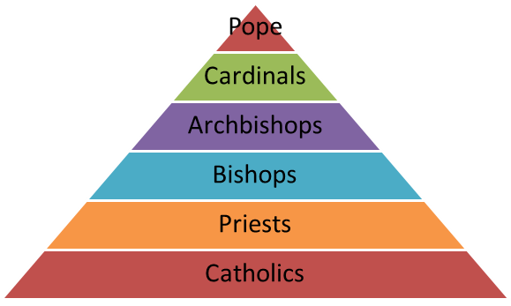

Slide 27
Ecclesiastical Appointments
(Investiture Controversy)
The pope can be judged by no one
He can depose emperors
He can absolute subjects from their allegiance
All princes should kiss his feet
He alone can call general councils and authorize cannon law
The Roman church has never erred and never will err till the end of time (do no wrong)
The Pope alone can dispose and restore bishops
A symbol of papal authority, Pope Gregory VII declared the church infallible and capable of removing emperors

Slide 28
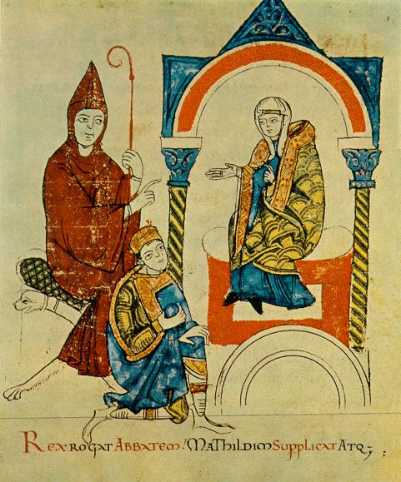
Ecclesiastical Appointments
(Investiture Controversy)
Secular vs religious power
Medieval struggle between the church and the lay lords to control ecclesiastical appointments
Broader conflict of popes versus emperors/kings

Slide 29
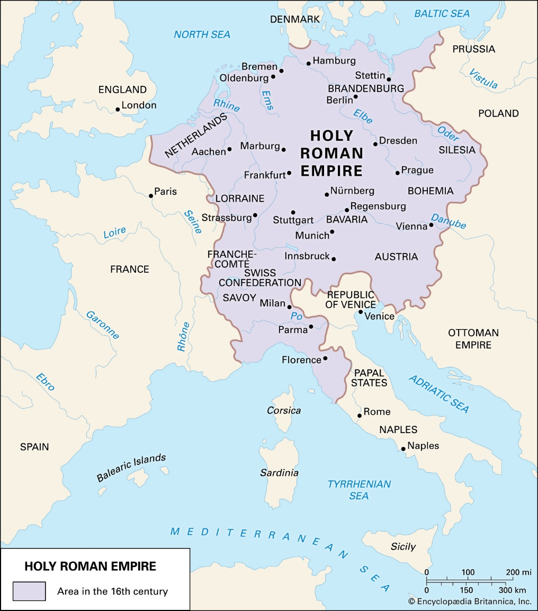
Holy Roman Empire
Not holy, or Roman, or an empire…
Multi-ethnic complex of territories that developed during the Early Middle Ages
The HRE was a series of independent princedoms that existed as a loose confederation, and the title of Emperor itself was an elected position, rather unusual for an Empire

Slide 30
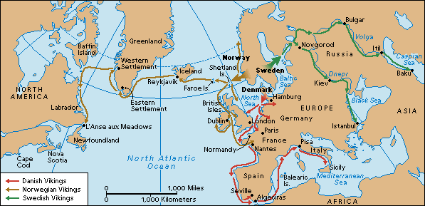
Viking Expansion

Slide 31
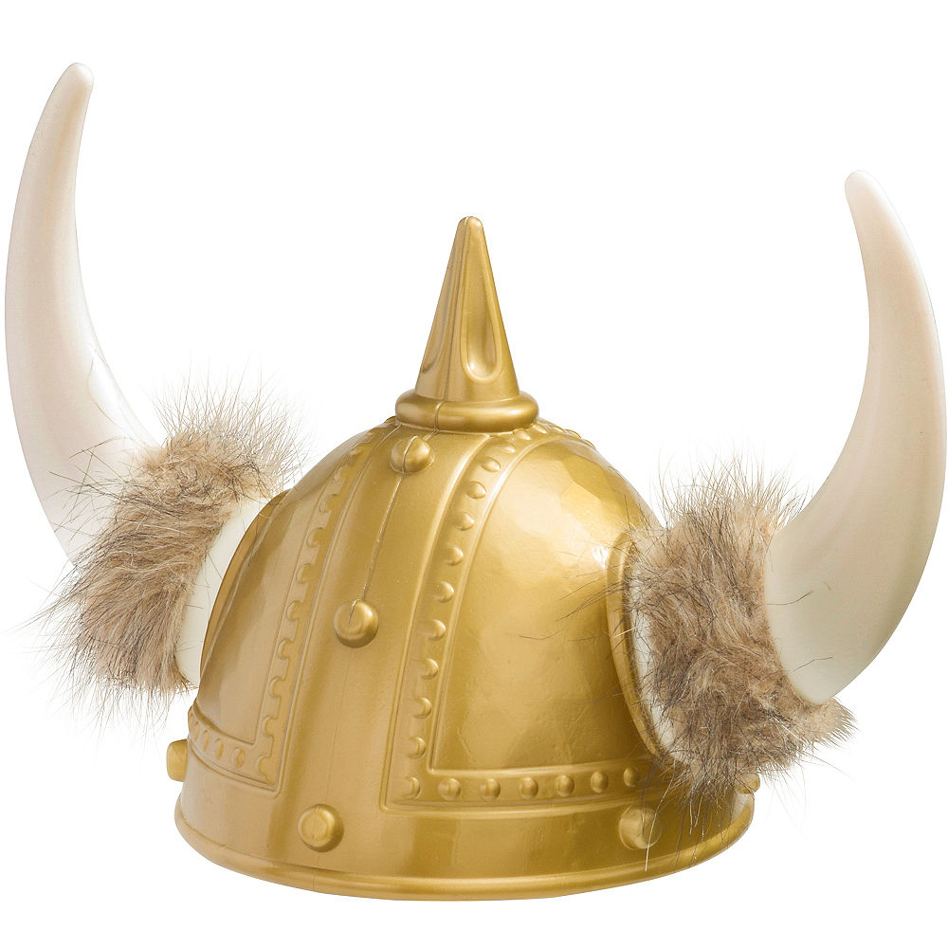
Vikings

Slide 32
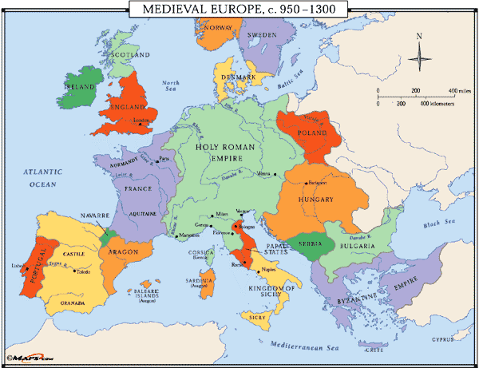
Europe in the High Middle Ages

Slide 33
Rise of Regional States
Holy Roman Empire (Germany)
  “neither holy, nor Roman, nor an empire”
  Conflicts with church prevented creation of a powerful state
France
  Capetian dynasty consolidated feudal estates into a centralized government
    Feudal monarchy
Italy
  Dominated by powerful city-states: Rome (papal state), Florence, Genoa, Milan, Venice, etc. (Medici fam)

Slide 34
Afro-Eurasia in 800 CE

Slide 35
Afro-Eurasia in 1400 CE

Slide 36
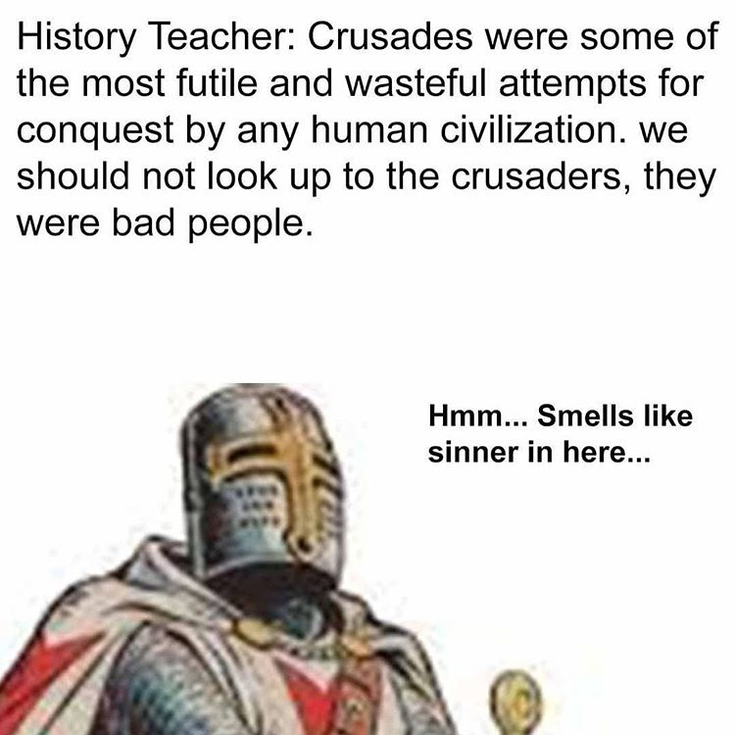
The Crusades (1096- 1291)

Slide 37
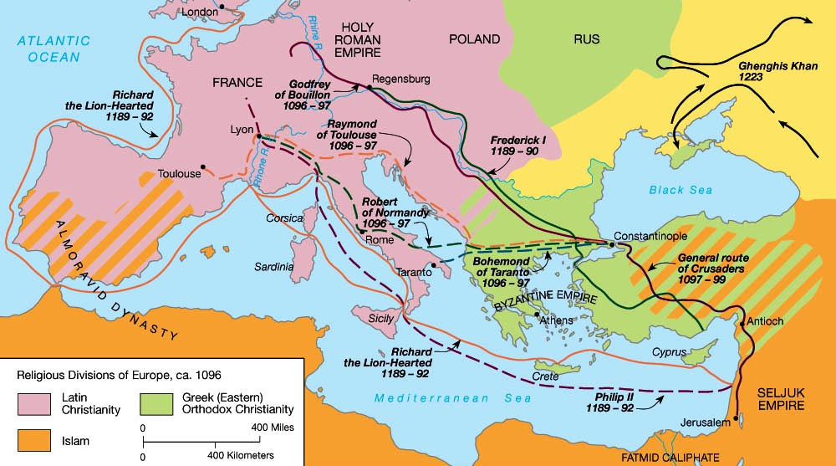
The Crusades (1096- 1291)

Slide 38
Causes
Just as Europeans fought to drive Muslims out of Sicily and Spain, they also sought to reclaim control of the Holy Land (Jerusalem)
Rules of primogeniture (lack of land and wealth)
Merchants wanted access to trade routes
Catholic Church incentives (promised get to heaven sooner)

Slide 39
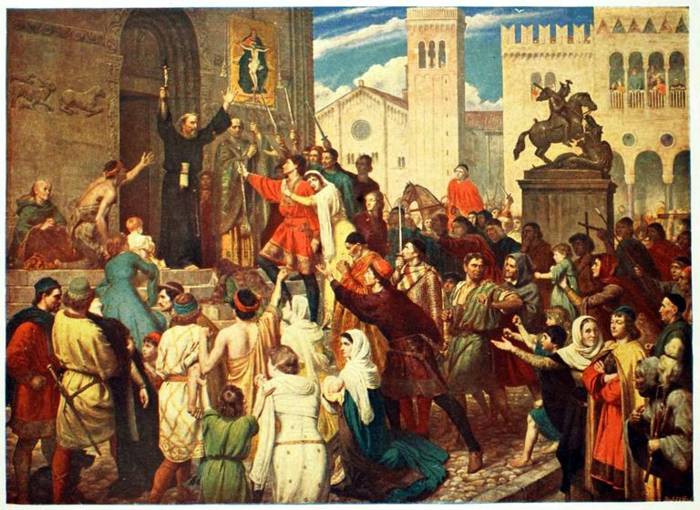
The Crusades (1096- 1291)
First Crusade (1095) Pope Urban II
Wanted to unite Europe (give them a common enemy)= Lets go help the Byzantines and liberate Jerusalem!
Crusade= pilgrimage with touch of war
No real leader/disorganized/rival nobles→ but 1st largely successful

Slide 40
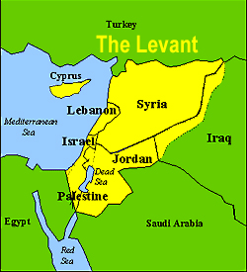
The Crusades
Levant (Siege of Antioch)
Peasant found spear that pierced Christ side= raised moral and took Jerusalem
Not against Turks but Egyptians
Turkish Muslims= Sunnis
Shia= Egyptians
Latin Christian kingdoms in the Levant

Slide 41
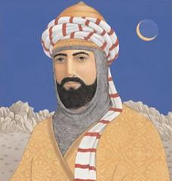
The Crusades (3rd)
Saladin: was the first sultan of Egypt and Syria. A Sunni Muslim, Saladin led the Muslim military campaign against the Crusader states in the Levant.
Pope Greggory 8th
Phillip of France
Richard the Lion of England
Frederick of Holy Roman Empire
Crusaders did not take Jerusalem but made taking Egypt a thing

Slide 42
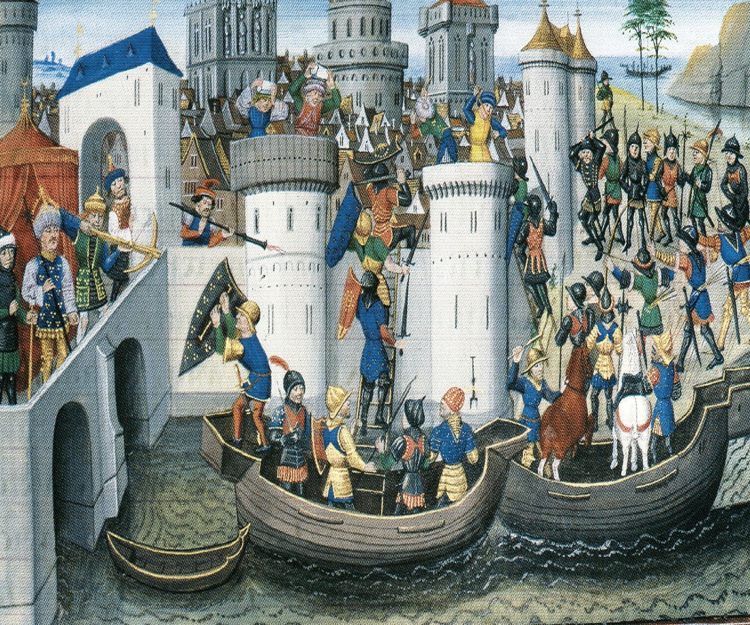
The Crusades (4th) (1202-1204)
In January 1203, en-route to Jerusalem, the Crusader leadership entered into an agreement with the Byzantine prince Alexios III to divert the Crusade to Constantinople and restore his deposed father as Emperor. The intent of the Crusaders was then to continue to Jerusalem with promised Byzantine financial and military aid.
Alexios III overthrown leaving Crusaders in Constantinople with no $$$
Crusaders took wealth, raped Christians, and retook exactly none of the holy land
Severely weakened Byzantine Empire

Slide 43
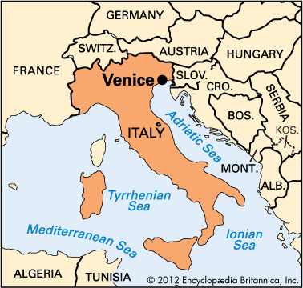
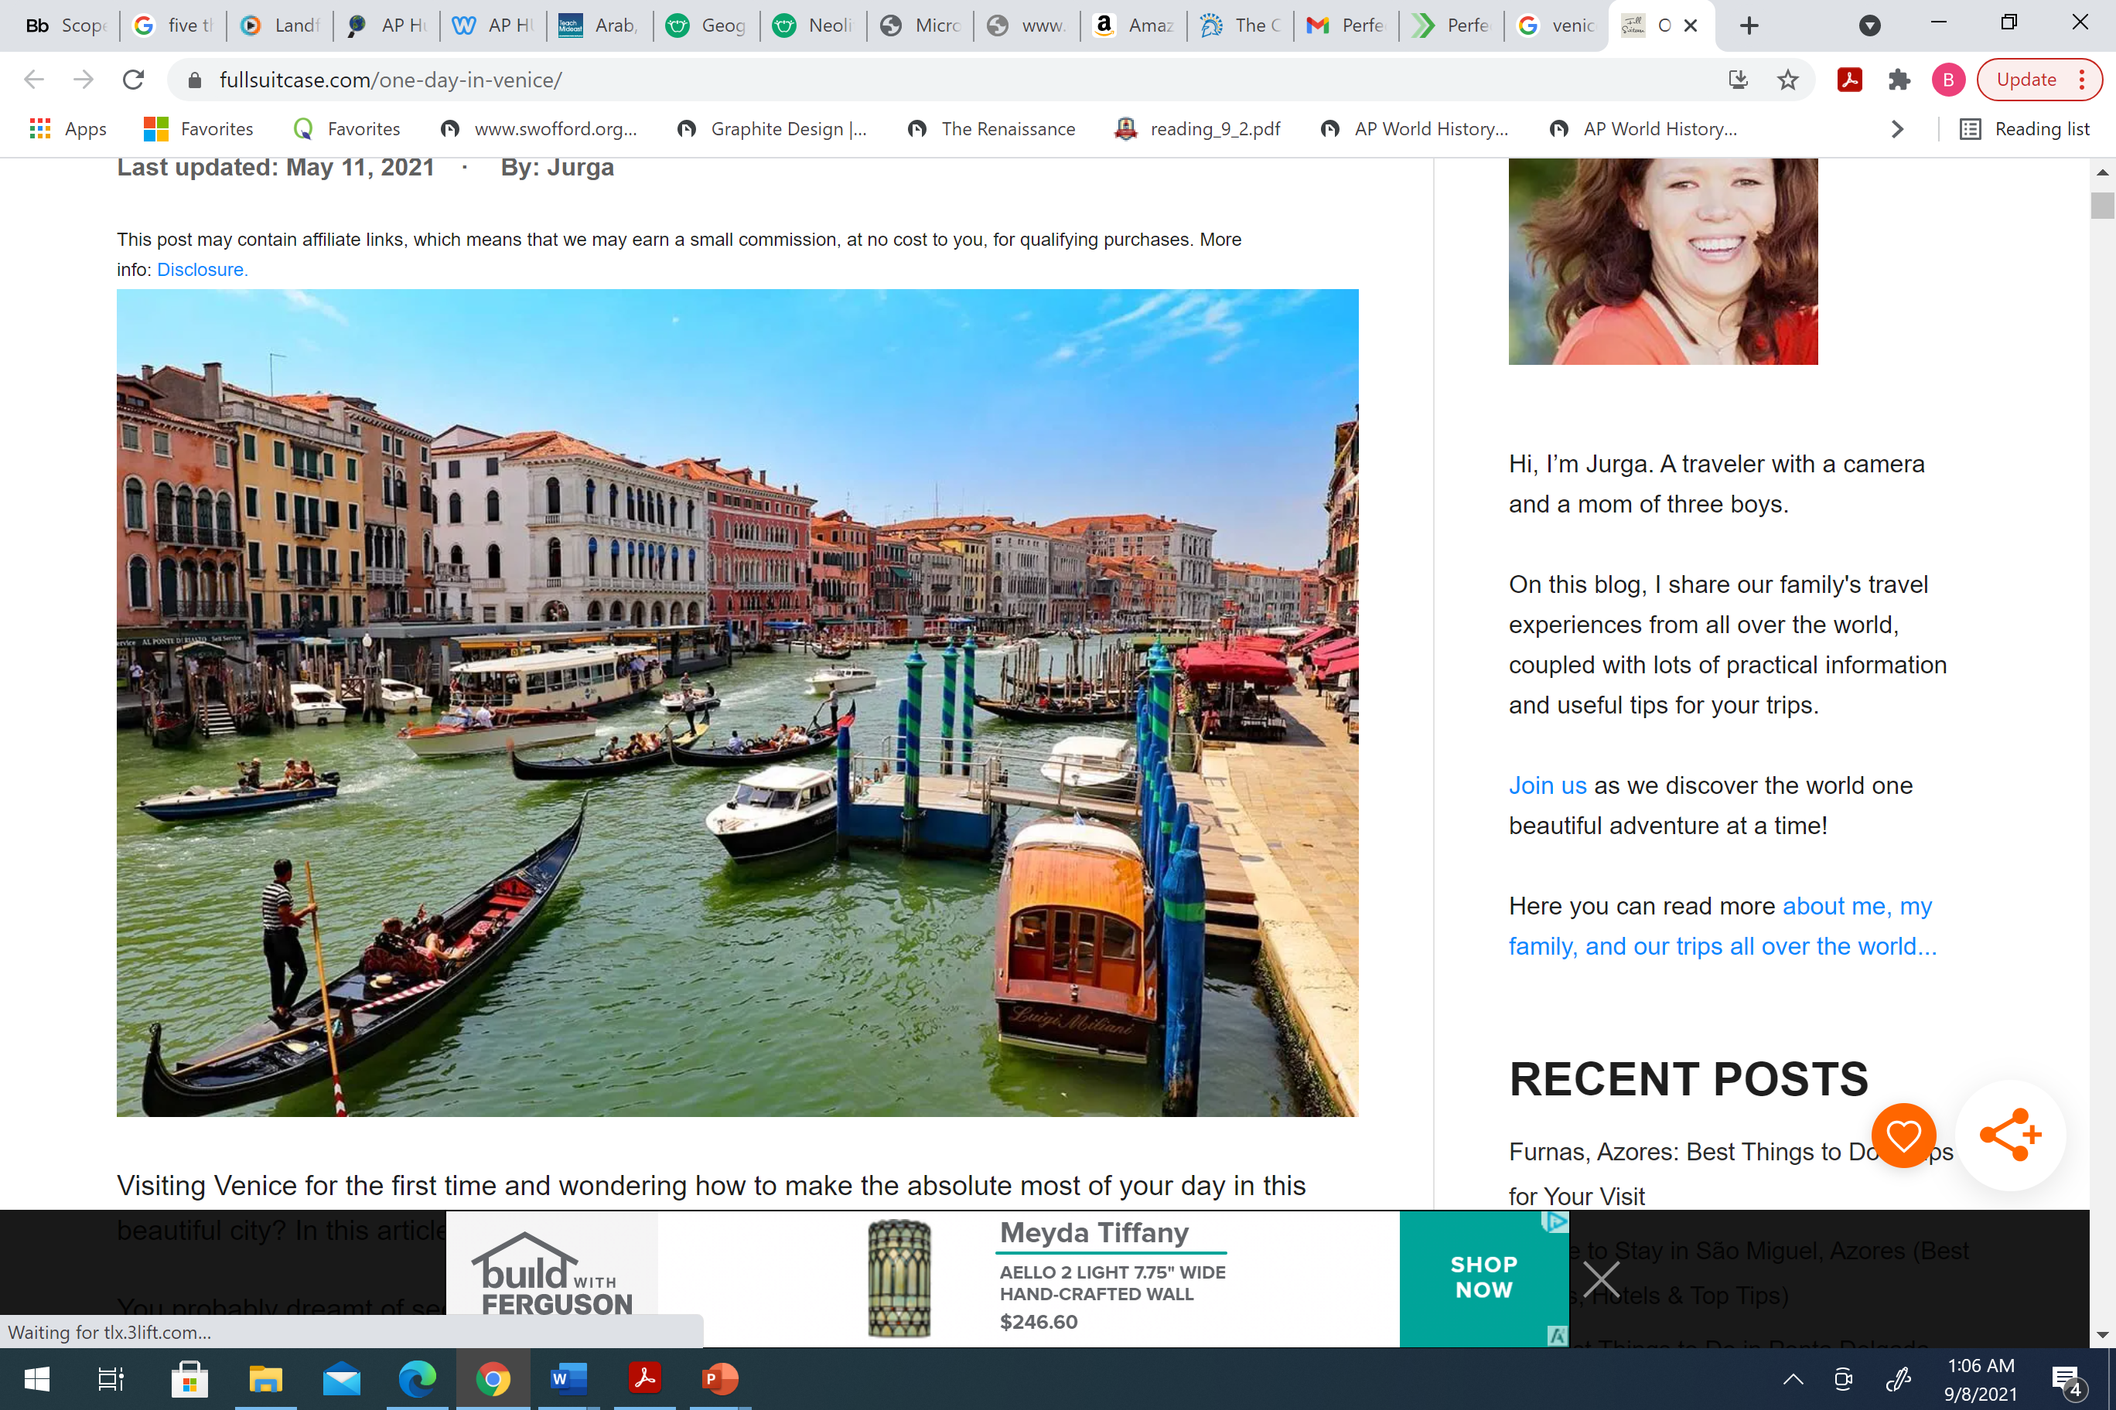
Venice (major trading center)

Slide 44
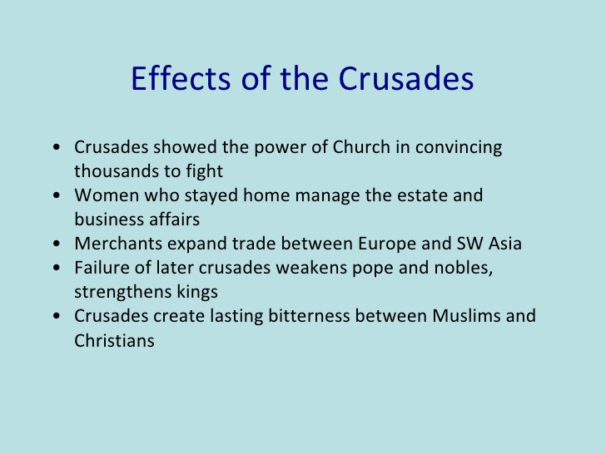
The Crusades Effects
ANY ENEMY OF THE CATHOLIC CHURCH WAS FAIR GAME
Doomed Byzantine Empire→ 1453 Turks over
TOTAL FAILURE for establishing Christian kingdoms in the holy land long term
Did not open lines of communication between Muslims and Europe (communication already existed)
Tremendous drain of Europe’s resources
Crusaders believed in their work but in many ways it ruined their faith and their lives
Muslim→ To European World (Greek philosophy, science, and medical works)

Slide 45
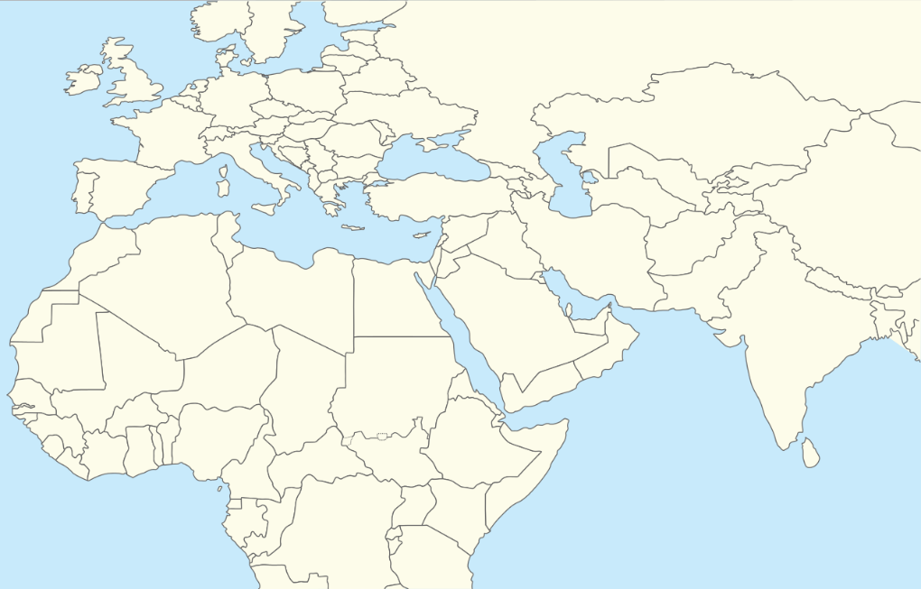
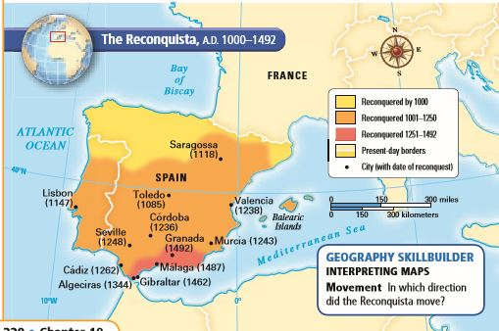
Spanish Reconquista (Crusading Mentality?)
The name given to a long series of wars and battles between the Christian Kingdoms and the Muslim Moors for control of the Iberian Peninsula. It lasted for a good portion of the Middle Ages from 718 to 1492.

Slide 46
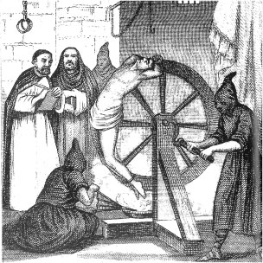
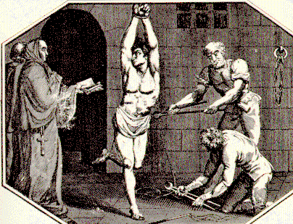
Spanish Reconquista
Began in small Christian states in northern Spain
By 1150 Christians had recaptured over half of Muslim Spain
  Aided by organization and wealth of Catholic Church
Ended in 1492 with conquest of Granada
  Drove Jews and Muslims from Spain
The Spanish Inquisition

Slide 47
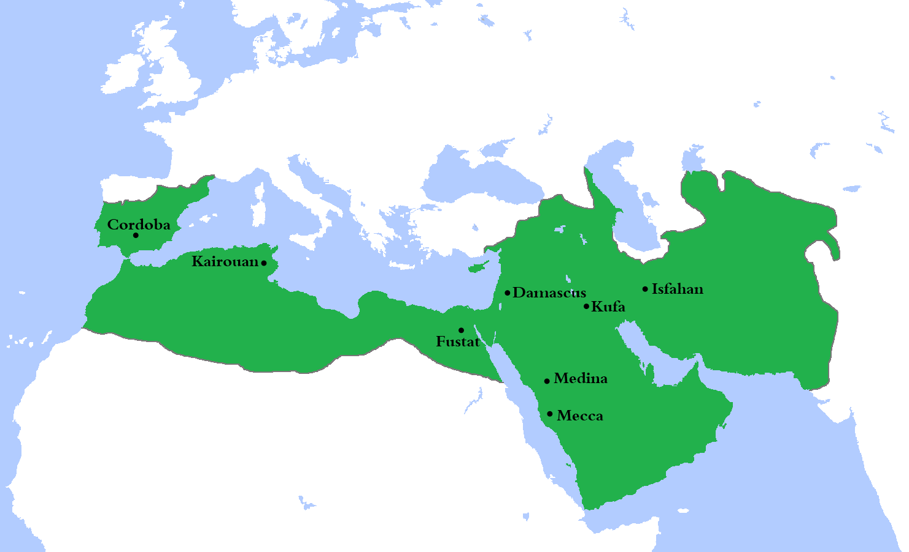

Slide 48
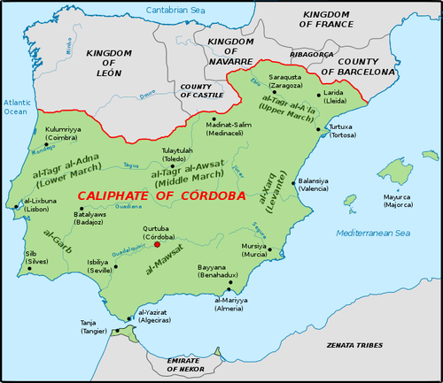

Slide 49
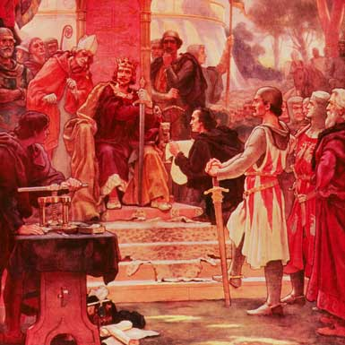
Rise of Monarchy in England
William of Normandy conquered England in 1066
  Feudalism with centralized approach
Magna Carta signed by King John in 1215
  Created parliamentary system
  Parliament must approve changes in taxation
  Does NOT create a democratic system
King John, enemy of Robin Hood, was forced to sign the Magna Carta in 1215

Slide 50
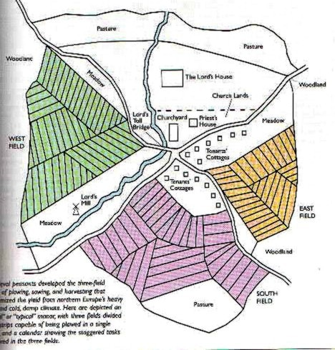
European Economic Revival
Changing Agricultural Economy
  Technology: improved plows, watermills, the horse collar, and the horseshoe
  Crop rotation and the three-field system
  Population growth
    800 CE—29 Million
    1100 CE—44 Million
    1300 CE—79 Million
Population growth led to urbanization
  London, Paris, Toledo, etc.
  Some towns challenged the authority of their feudal lord

Slide 51
European Economic Revival
Urbanization increased specialization of labor
  Guilds created regulations between craftsmen
    Protect prices, regulate production, etc.
Specialized labor increased manufacturing
  Manufacturing focused on wool textiles
  Woolen textiles dominated by Italy and Flanders (Belgium)
Increased manufacturing led to increased trade
  Italian merchants dominated trade in the Mediterranean
  Increased involvement in the Afro-Eurasian trade network
    Silk Roads, Trans-Saharan, etc.
  Hanseatic League promotes trade in northern Europe

Slide 52
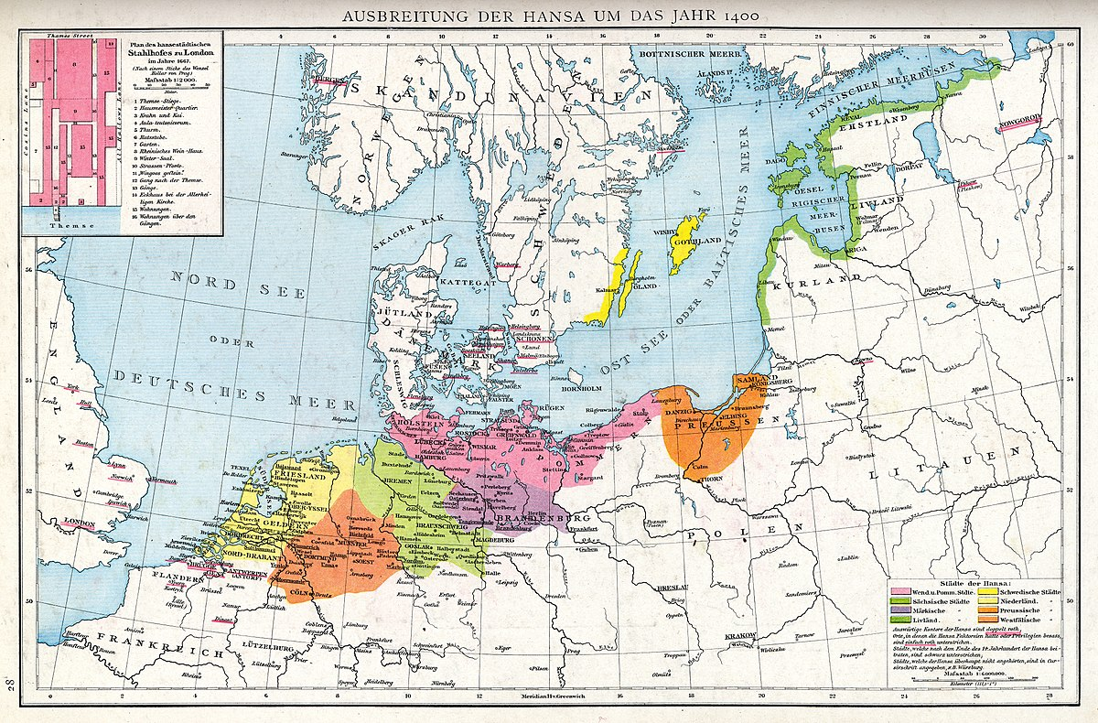
Hanseatic League (Est. 1358)

Slide 53
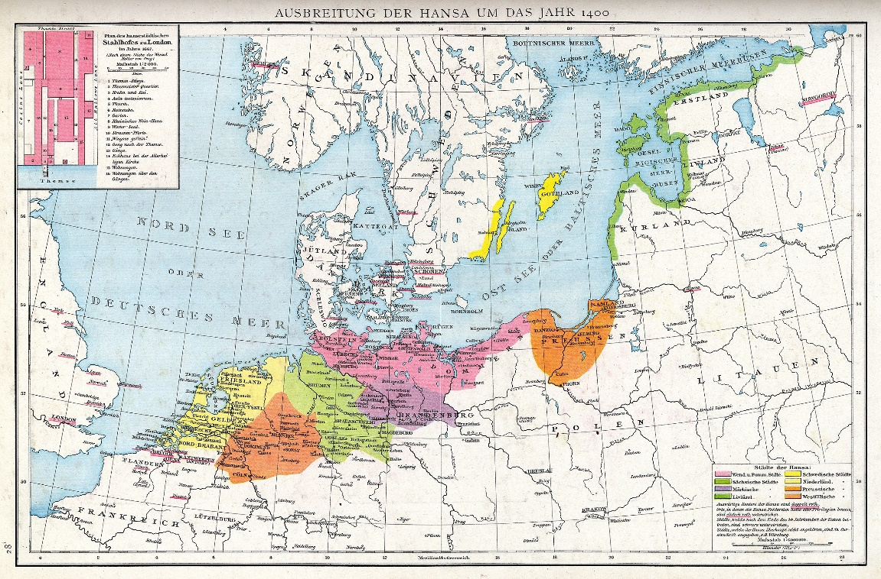
Hanseatic League
a commercial and defensive confederation of merchant guilds and market towns in Northwestern and Central Europe
Merchant circles established the league to protect the guilds' economic interests and diplomatic privileges in their affiliated cities and countries, as well as along the trade routes which the merchants used. The Hanseatic cities had their own legal system and operated their own armies for mutual protection and aid. Despite this, the organization was not a state, nor could it be called a confederation of city-states

Slide 54

Trade in the High Middle Ages
Venetian and Genoese merchants established colonies in major trade ports of Alexandria, Constantinople, Cairo, Damascus, etc.

Slide 55


Social Developments
Status of women improved
  Chivalry promoted respect for women
  Urbanization created more job opportunities for women
    All-female guilds
  Worked same jobs as their husbands
  Increased veneration of the Virgin Mary
    Mary symbolized ideals of womanhood, love, & sympathy
Cathedral of Notre Dame or “Our Lady”

Slide 56


Slide 57


Slide 58


Slide 59


Slide 60
Christianity in the High Middle Ages
Cathedral schools become universities
  University of Paris, Oxford University, etc.
Rediscovery of works of Aristotle
  Increased commerce with Muslims provided the West with access to Greek works
New intellectual movements
  Thomas Aquinas and scholasticism
    Combining Aristotle’s logic with Christianity to create the most truthful system of thought possible
Some reformers within in the church were worried about the materialism of the church

Slide 61

Jewish People
Guilds
Jews predominated in moneylending
Charged interest
Mostly lived in cities
Jews endured violent religious persecutions and expulsions, especially during the Black Death

Slide 62
End of the Middle Ages
The Little Ice Age
The Hundred Years War
Bubonic Plague
The Italian Renaissance

Slide 63

The Little Ice Age (Started in 1300s)

Slide 64

Hundred Years War (1337 to 1453)
A series of periodic military campaigns between England and France
New technology
  Crossbows, longbows, pikes, firearms, and cannons
    Castles & knights outdated
Monarchs maintain permanent militaries

Slide 65

Hundred Years War (1337-1453)
Battle of Agincourt (1415)
French and English nationalism
Feudal armies → heavy cavalry→ artillery
However, the greater resources of the French monarchy prevented the English kings from ever completing the conquest of France.

Slide 66


Joan of Arc

Slide 67


Slide 68
Bubonic Plague
Silk Roads spread bubonic plague across Eurasia in the 14th century
In October 1347 a ship from the Crimea sailed into Messina. The crew had a "sickness clinging to their very bones.“
Rats carrying fleas got on shore spreading disease
  Increased trade helped spread the plague
  Close proximity, unsanitary conditions facilitated the spread into cities
25 million people died in the next several years, 1/4 to 1/3 of the population of Europe
  Population rebounded within 200 years

Slide 69

Spread of Bubonic Plague

Slide 70

Spread of Bubonic Plague

Slide 71


Slide 72



The Black Death
Victims “ate lunch with their friends and dinner with their ancestors in paradise”
-Geovanni Boccaccio

Slide 73
Impact of the Bubonic Plague
Profound impact on manorial economy
  Labor became scarce in some places
  Tenants, rent payers, made gains as feudal obligations were lowered
  Some serfs were freed to keep them from running away to better opportunities
  Wages rose in towns to keep workers happy
“The path to the Industrial Revolution began with the Black Death. The population fall increased labor mobility by creating many vacant farms, and that mobility undermined serfdom.” - Robert Allen

Slide 74





Italian Renaissance
Started in Italy during the 13th century
  Why Italy?
    Urban Growth & Wealth
    Merchant Class Values
    Classical Heritage
Main Idea: humanism
  Study of human beings and human potential
    Celebration of human life
  Many different approaches to humanism
It is better to be feared than loved, if you cannot be both.

